Slide 1
DC TRIATHLON CLUB
2014 Annual Meeting & Kona Viewing

Slide 2
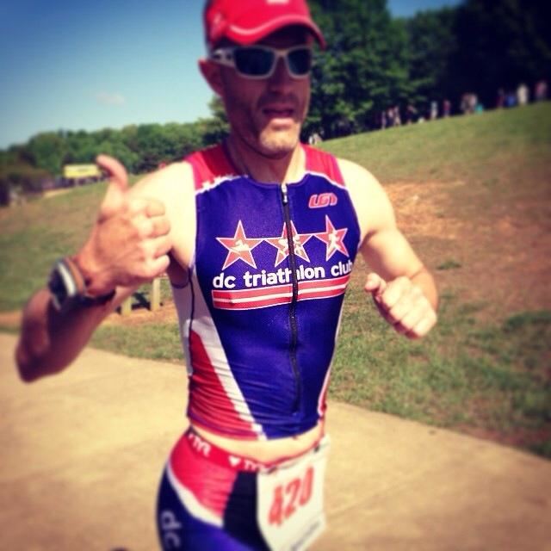
Welcome
Ryan Troll, President

Slide 3
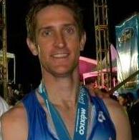
Financial Report
Stephen Carlson

Slide 4
Financial Report - Growth

Slide 5
Financial Report – Functional Areas

Slide 6
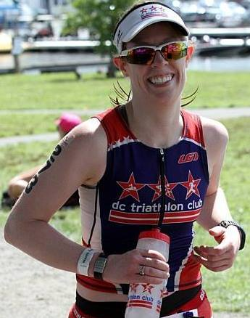
Membership Update
Angela Norcross,
Director of Club Events

Slide 7


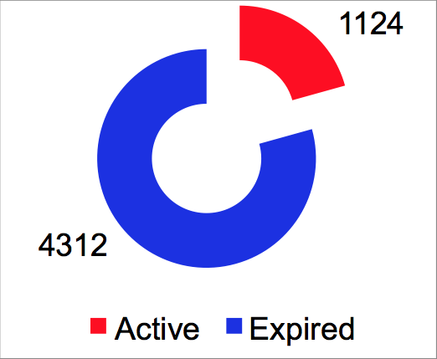
Membership Demographics
48%
51%
Notes:
7

Slide 8
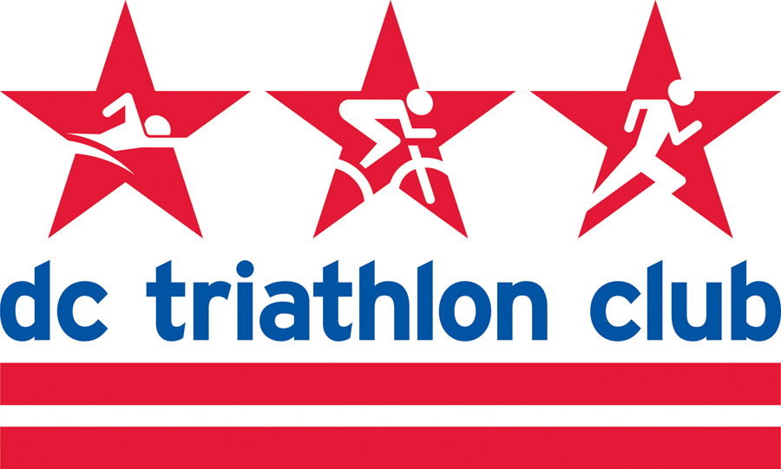
2014 Program Highlights

Slide 9
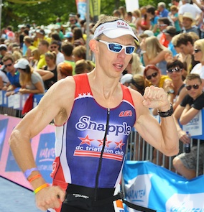
Programs
New Triathlete Program (NTP)
Very successful this year! Class of 200 participants! Largest ever.
Dominated Black Bear Triathlon (won Participant Challenge AND Competitive Challenge)
Informational meeting for 2015 class – January 10th. Registration opens January 12th.
Goal race: Black Bear Triathlon on May 31, 2015 (slots will be reserved for participants).
2014 Program Leaders - Pamela Simmonds, Jason Brezinski, Catharine Myung, Mark Raugust, Allison Nordberg, David Payne, Andrea Schiller and Coach Will Grant
Bryan Frank
Olympic Distance Program (ODP)
After successful revamp of the program, expanded to TWO classes this year.
First class: Black Bear Triathlon (14 participants).
Second class: Nation’s Triathlon (30 participants).
Adding a “Beginner” training plan for people who just want to work up to an Olympic triathlon.
Spring class opens – 2/2/2015 and program starts 2/23/2015.
2014 Program Leaders – Coaches Brady Nelson and Julianne Miata

Slide 10
Programs
Half Ironman Program (HIP)
Good year for the program. Class of 25 participants.
About a third did goal race at Musselman in rough conditions.
Registration for 2015 opens in December.
Goal race: Eagleman 70.3 – Cambridge, MD.
  Registration for the race is now open!
  Training plan would start 1/26/2015.
Program start date can be adjusted for other races but clinics scheduled around the key race.
2014 Program Leaders – Coach AJ Morrison, Christopher Jackson, Cindy Hutchings, Dena Richardson, Steve O’Donnell, Diane Donahue, and Simon Hernaez
Bryan Frank
Ironman Program (IMP)
Grew from last year! Class of 18 participants.
About ¼ did the goal race of Ironman Chattanooga.
Registration for 2015 opens in December.
Goal race: Ironman Maryland (Registration is now open; Training plan would start 4/6/2015).
Program start date can be adjusted for other races but clinics scheduled around the key race.
2014 Program Leaders – Coach AJ Morrison, Matt Ferguson, Kimberley Kruse, Lynn Follansbee, Stephanie Brown, Patrick Pannett, and Karen Willard

Slide 11
Programs
Masters Swim Program (MSP)
The only Masters program geared toward triathletes to provide skills necessary to excel in open water.
Morning and evening swims at UDC and Wilson three times a week. Also have weekend courses (Intro to Swim, Technique, Intermediate & Advanced Skills).
Registration is always ongoing.
For 2014, moved primarily to an monthly unlimited pass with offseason discounts.
2014 Program Leaders – Nikki Allem, Nams Ammons, Claudia Blackburn, James Chu, Tom Colicchio, Rachel Dolan, Lizzie Noll, Mary Liebman, Catharine Myung, Julianne Miata, Kim Orsulak, Emerson Padiernos, David Payne, Bryan Piacentini, Liana Rosen, Will Schaffer, Katie Tobin, Mike Tyson, and Karen Willard
Bryan Frank
Off Season Spin Program (OSS)
Sold out both classes for 2014 with lots of positive reviews.
Saturday session at Edgewood Arts Center in Brookland; capacity: 100 people
Sunday session at Off-Road Cycling Studio in DC; capacity: 24 on spin & on 12 personal bikes
Registration for 2015 is already SOLD OUT. Program begins January 10th and 11th.
Program Instructor– Ron Benedict

Slide 12
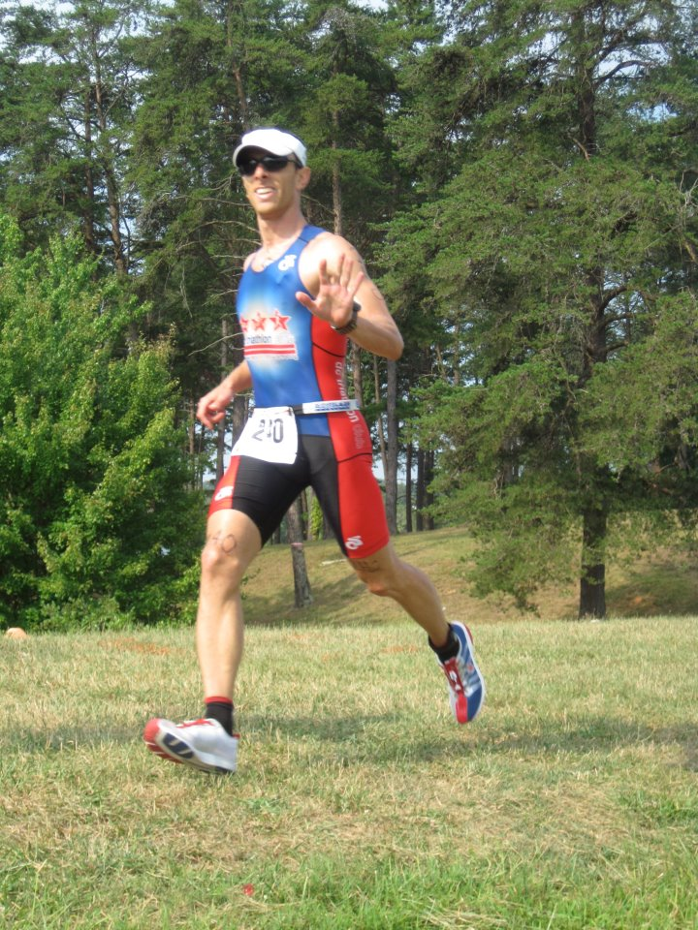
Club Racing
2014 Club Races/Competitions
National Club Challenge Competition Champions!
8-time Mid-Atlantic Regional Club Champions!
Swim Meets: 101 and Battle of the Tri Clubs
Duathlons #1, #2 and #3
Training Triathlons #1 and #2
Rock Creek Park Spooky Sprint 5k/10k
Adam Stolzberg
Thanks to all DC Tri Training Ambassadors!
Masters Swim Program Team
Lee Boyer
Holli Finneren
Hillary Peabody & subs
Patrick Serfass
Hilary Cairns
Mark Raugust
David Eng
Amanda Chadwick
Tuan Nguyen
Rachel Gottfried
Thanks to Brick-Nics, North East and Deep Creek Lake Training Weekend Leads:
Justin Bauer
Allison Herren
Robin Myers
Murdoch MacNeil
Khang Ho

Slide 13
2015 Club Races
Swim Meets at the Catholic University of America
  Swim Meet 1: Sunday, February 8 (tentative)
  Swim Meet 2: Battle of the Tri Clubs - Sunday, February 22 (tentative)
Training Duathlons & Time Trials
  Duathlon 1: Sunday, March 8, 9 AM @ Hains Point South Lot
  Time Trial 1: Sunday, March 15, 8:30 AM @ Hains Point South Lot
  Duathlon 2: Sunday, March 28, 8 AM @ Anacostia Park, Section E
  Time Trial 2: Saturday, April 11, 7:30 AM @ Anacostia Park, Section E
Splash ‘n Dash at Marymount University
  April 2015 (tentative)
Spooky Sprint 5k/10k Trail Run
  Sunday, November 1, 3:30 PM
Adam Stolzberg

Slide 14
2015 Featured Races
Kinetic Triathlon, Half and Sprint distances, May 9-10
Rev3Rush, May 30-31
Black Bear Triathlon, Olympic distance, May 31
  NTP and Olympic Distance Program I goal race
Eagleman 70.3, Half distance, June 14
  Half Ironman Program goal race
New Jersey State Triathlon, Olympic distance, July 18-19
  USAT Mid-Atlantic Club Championships
Luray Triathlon, Sprint and Olympic distances, August 15-16
Nation’s Triathlon, Sprint and Olympic distances, September 13
  Olympic Distance Program II goal race
Ironman Maryland, Full distance, October 3
  Ironman Program goal race
Ironman Barcelona, Full distance, October 4
Adam Stolzberg

Slide 15
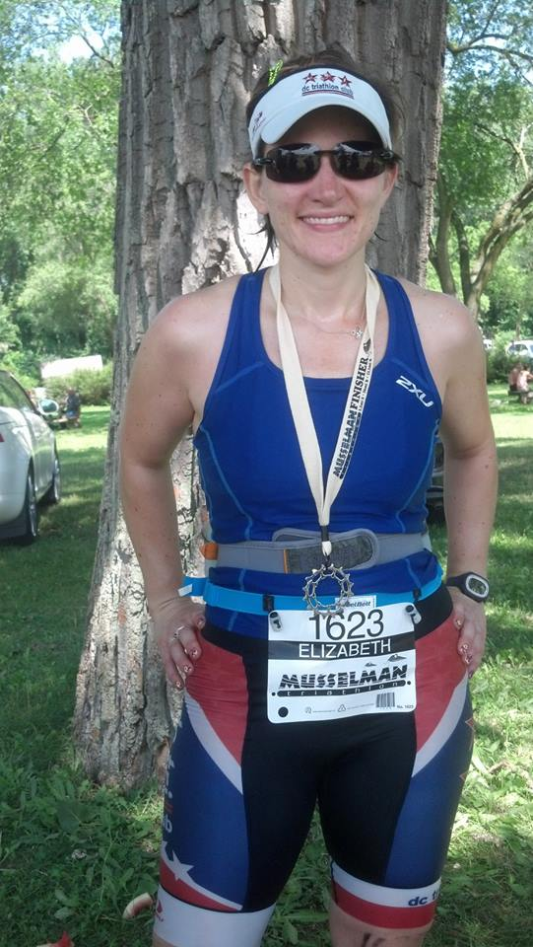
Community Groups
Elizabeth Corona, Director of Community Groups

Slide 16
Community Groups
TriOut – A community group of gay, lesbian, bixsexual, and transgender (LGBT) Club members and friends looking to train, socialize, and interact
  lgbt@dctriclub.org
  Request membership on the TriOut Facebook page
Montgomery County (“Mafia”) – A community group of Club members who live, work, and/or train in Montgomery County, MD
  Request membership on the Moco Mafia and Friends Facebook page
Capitol Hill – A community group of Club members who live, work, and/or train on Capitol Hill
  caphill@dctriclub.org
  Request membership on the Google Group
  https://groups.google.com/forum/#!forum/dc-tri-cap-hill
In 2015 pace groups for various speeds will be incorporated into our training opportunities
If you are interested in forming and leading/co-leading a community group contact Elizabeth Corona at community@dctriclub.org

Slide 17
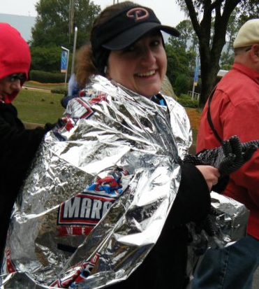
Partnerships
Robin Myers, Director of Partnerships & Outreach
Notes:
17

Slide 18








2015 Partner Lineup
Local Partnerships

Slide 19




2015 Partner Lineup
Online Merchant Partnerships

Slide 20
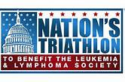





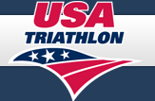


2015 Partner Lineup
Race Partnerships

Slide 21
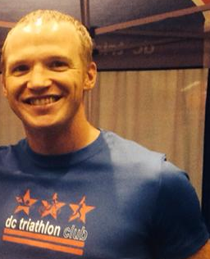
Volunteer Recognition
Presented by Nik Pleish, Director of Volunteers

Slide 22
Volunteer Recognition
Volunteers are key to our success!
In 2014, club members donated more than 5,000 hours of their collective time
Hundreds of members volunteered their time in 2014 to support the club and our partners
The following members were recognized by their peers as going above and beyond…
Amanda Chadwick
Pam Simmonds
Will Grant
Chris Jackson
Cat Myung
Allison Nordberg
Steve O’Donnell
Jen Carroll
Ed Moser
Tuan Nguyen
Jason Brez
David Payne
Mark Raugust
David Eng
Hillary Peabody
Stephanie Brown
Patrick Pannett
Khang Ho
Cindy Hutchings
Dena Richardson
Sean Pierce
Diane Donahue
Lynn Follansbee
Kimberley Kruse
Karen Willard
Pablo Torres

Slide 23
2015 Board of Directors & Staff
Presented by Ryan Troll

Slide 24
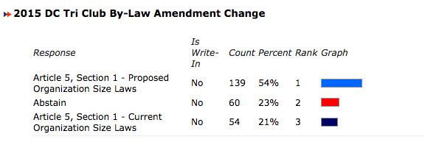
Board Governance
Article 5, Section 1 - Proposed Organization Size Laws
Section 1. Number. The affairs of this organization shall be governed by the Board of Directors composed of a minimum of five (5) and a maximum of ten (10) fifteen (15) members The number of Directors may be changed by a vote of the members at any annual or special meeting; provided, however, that no such change shall operate to extend or curtail the term of any elected Director.

Slide 25
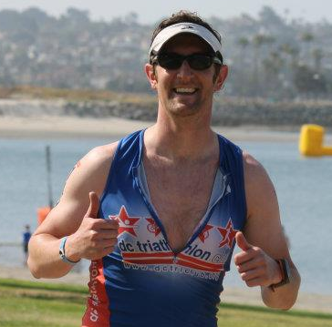
Special Thanks…
Ryan Troll
Adam Stolzberg
Stephen Carlson

Slide 26
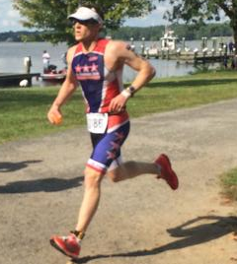
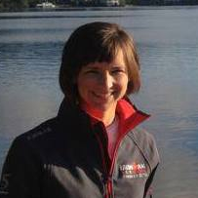
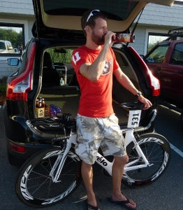
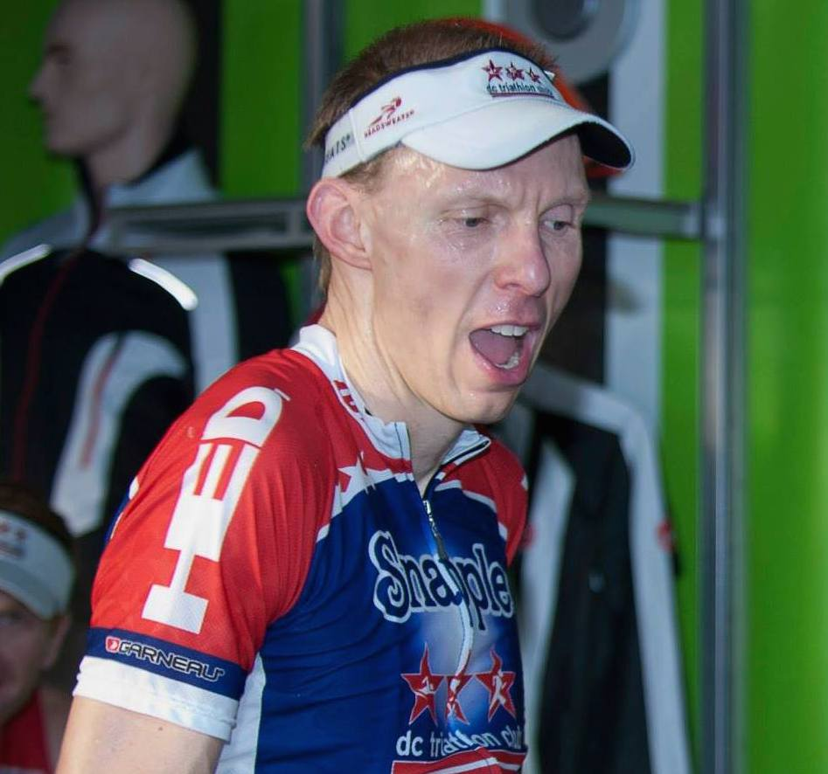
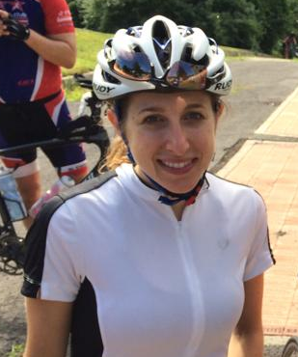
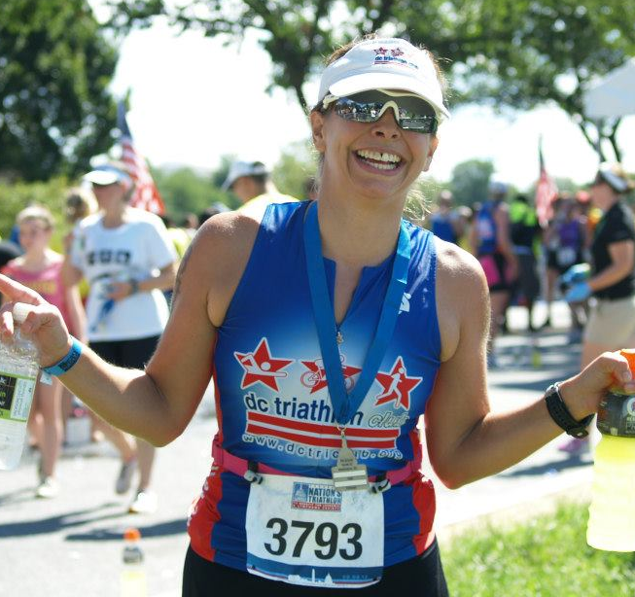
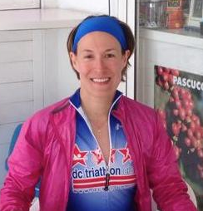
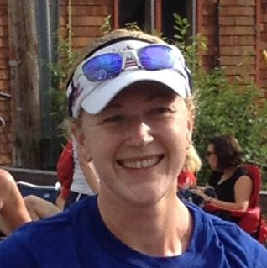

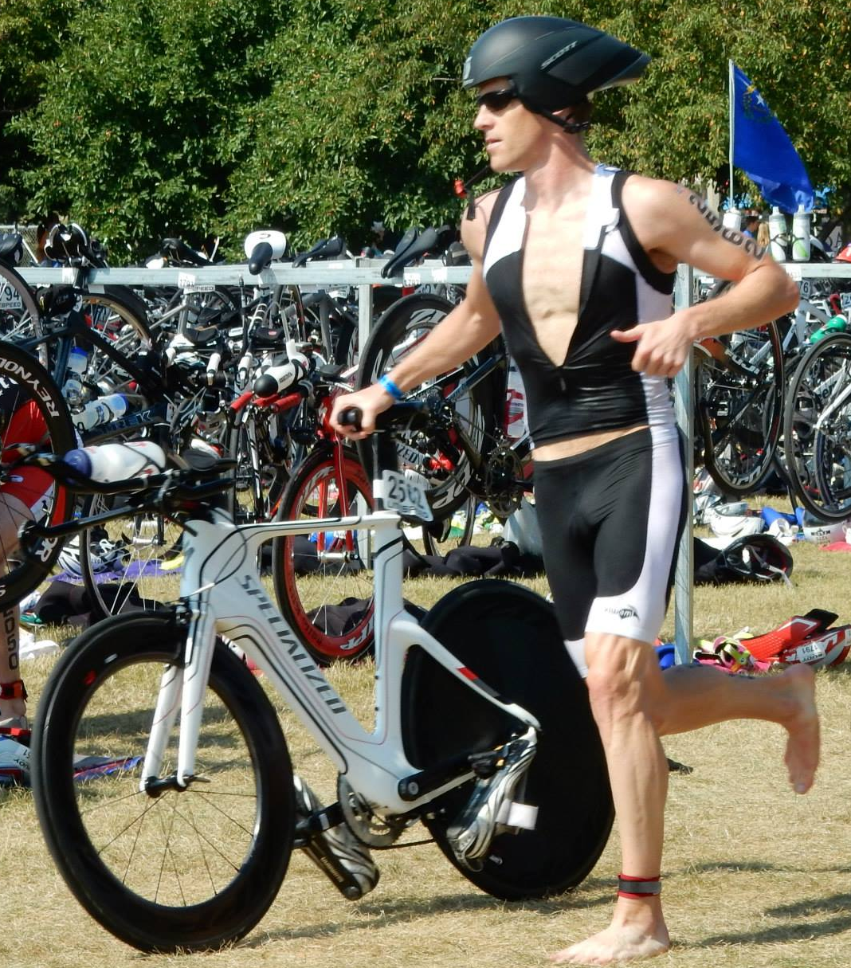
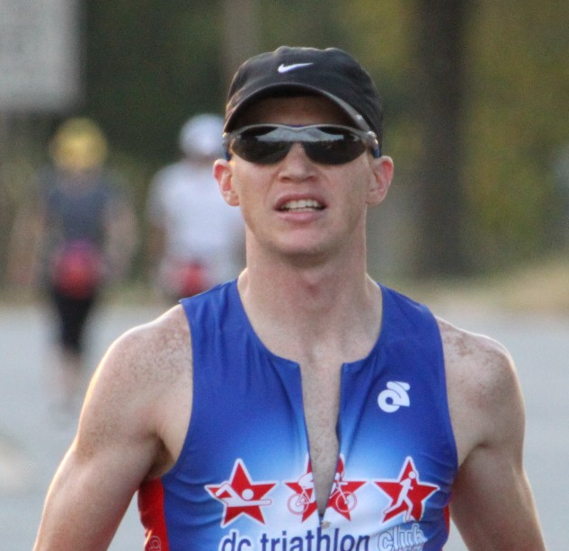
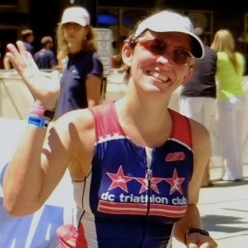
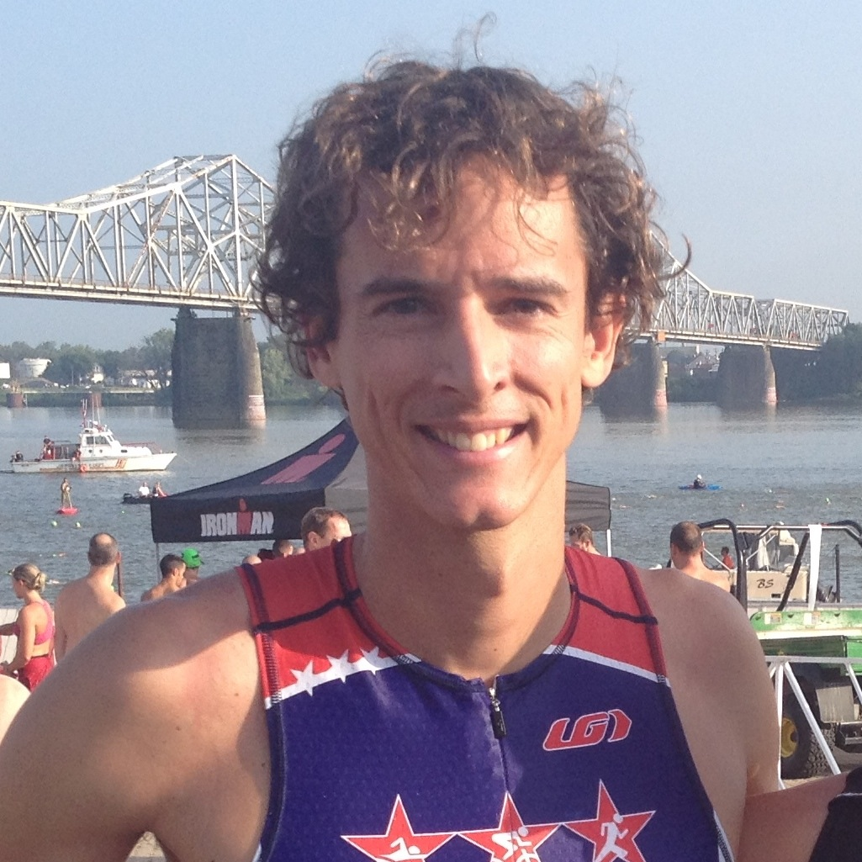
2015 Board of Directors
Justin Bauer
Elizabeth Corona
Rachel Dolan
Matt Ferguson
Bryan Frank
Rachel Gottfried
Jennifer Hartz
Becky Hirselj
Meaghan Jennison
Robin Myers
Angela Norcross
Bryan Piacentini
Nik Pleisch
Gabi Torres
Pablo Torres

Slide 27
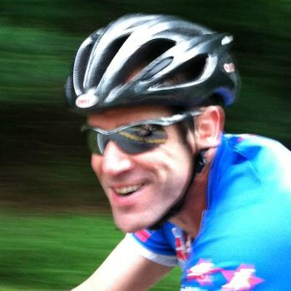
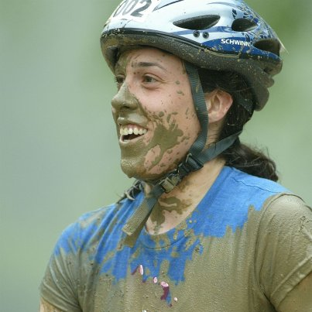
2015 Board Advisors & Staff
Ryan Troll
Transition Advisor
Rob Falk
Legal Advisor
Adrienne Farfalla
Staff

Slide 28
DC Triathlon Club Snapple Team
Presented by Bryan Frank

Slide 29
2014 DC Tri Club / Snapple Team
Another year of racing and another year of successes!
The DC Tri Club / Snapple Elite team was heavily used by ODP, HIP and IMP
  Swim, bike handling, and running clinics
  Transition and race strategy clinics
Highlights of race results from the team:
  Overall podiums (top 3 overall): 24 out of 57 races with 8 wins, 4 second places, 2 third places.
    Wins: 2 each for Joe Munchak and Emily Richard, 1 each for Stephanie Brown, Hilary Cairns, Holli Finneren, and Bryan Frank
    Dominated the podiums at North East Triathlon (males & females) and Nation’s Triathlon (females)
  Age group podiums (including overalls): 38 out of 57 races with 10 AG wins out of 57 races
  Exotic locals visited to represent DC Tri Club / Snapple:
    Hawaii (Ironman)
    Edmonton, Alberta (ITU Worlds)
    Chicago, IL (ITU Series)
    Thurmont, MD (Sprint)

Slide 30
2014 DC Tri Club / Snapple Team
Some Highlights:
  Joe Munchak – Kona finisher
  Monticelloman
    Joe Munchak – 1st overall (Olympic)
    Mindy Ko – 3rd overall (Half)
  North East Triathlon International
    Joe Munchak – 1st overall
    Bryan Frank – 2nd overall
    Hilary Cairns – 2nd overall
    Emily Richard – 4th overall
  Nation’s Triathlon
    Hilary Cairns – 1st overall
    Emily Richard – 2nd overall
  Giant Acorn International
    Hilary Cairns – 1st Age Group
    John Chambers – 1st Age Group
    Sean Pierce – 1st Age Group
    David Kraft – 2nd Age Group
  Williamsburg Olympic
    Jenny Leehey – 2nd Age Group
    Sean Pierce – 1st Age Group
  Luray Triathlon
    Matias Palavecino – 1st AG (Sprint)
    Jenny Leehey – 1st AG (Sprint)
    Emily Richard – 2nd AG (Sprint)
    Emily Richard – 2nd AG (Olympic)

Slide 31
2014 DC Tri Club / Snapple Team
Benefits to the club:
  Increase the value that we can offer industry sponsors by serving as brand ambassadors within the club and on social media.
  Bring more visibility to the club and better discounts for the members.
Direct examples:
  Rev3 Triathlon
  Bike partnership
  Working on another deal for race wheels (formerly HED)

Slide 32
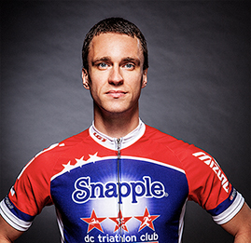
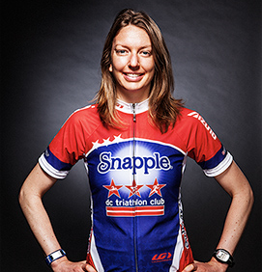
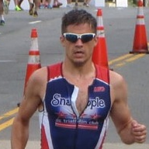
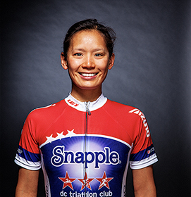
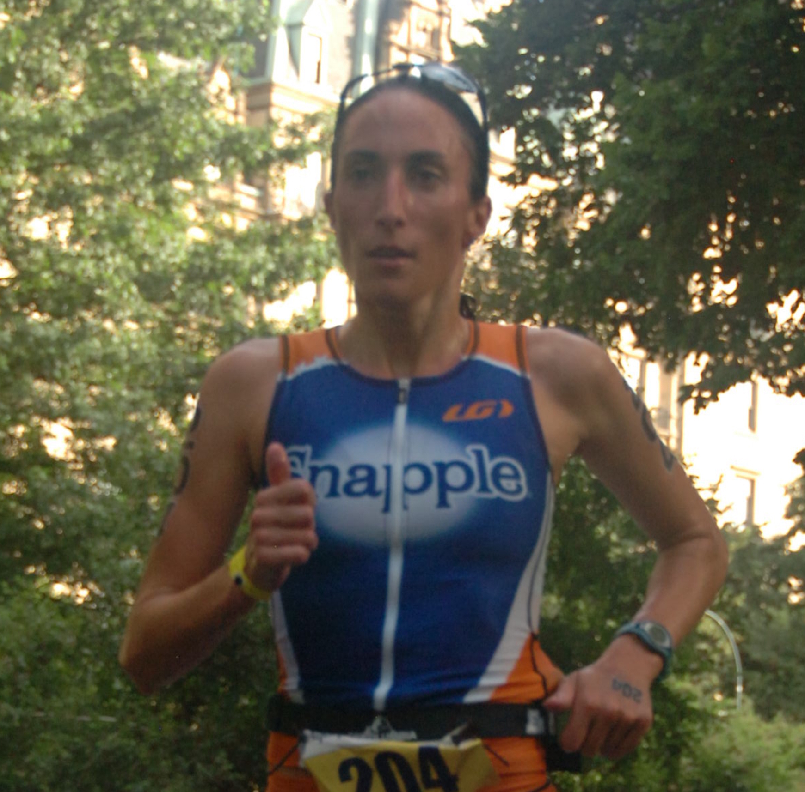
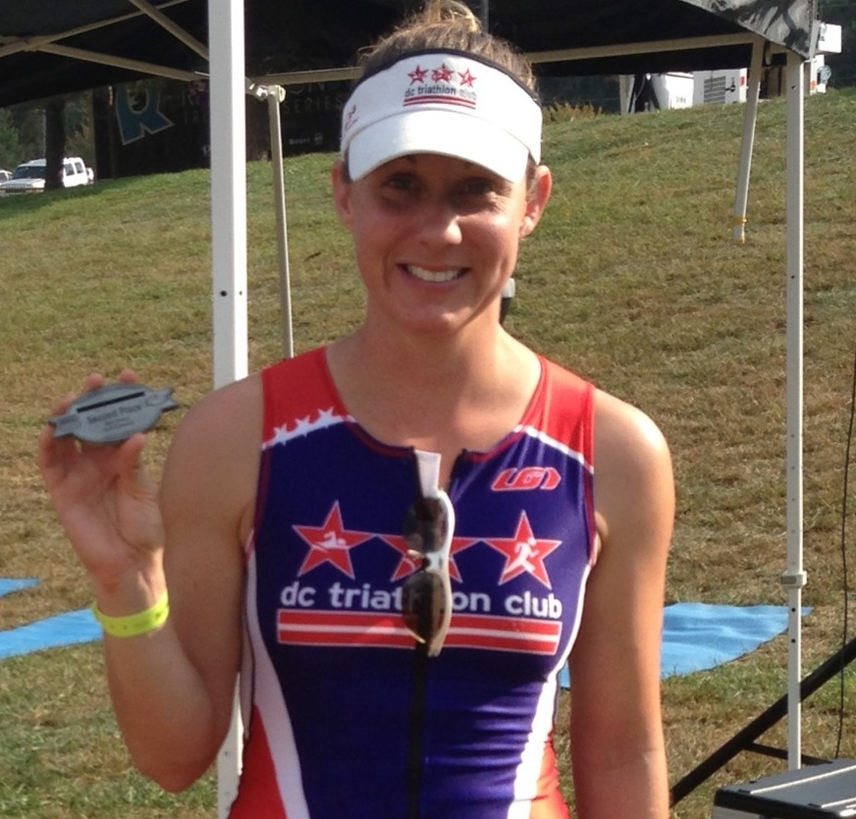
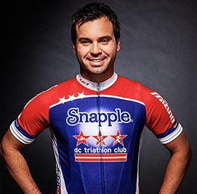
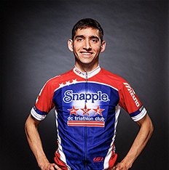
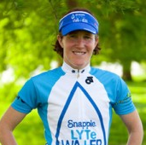
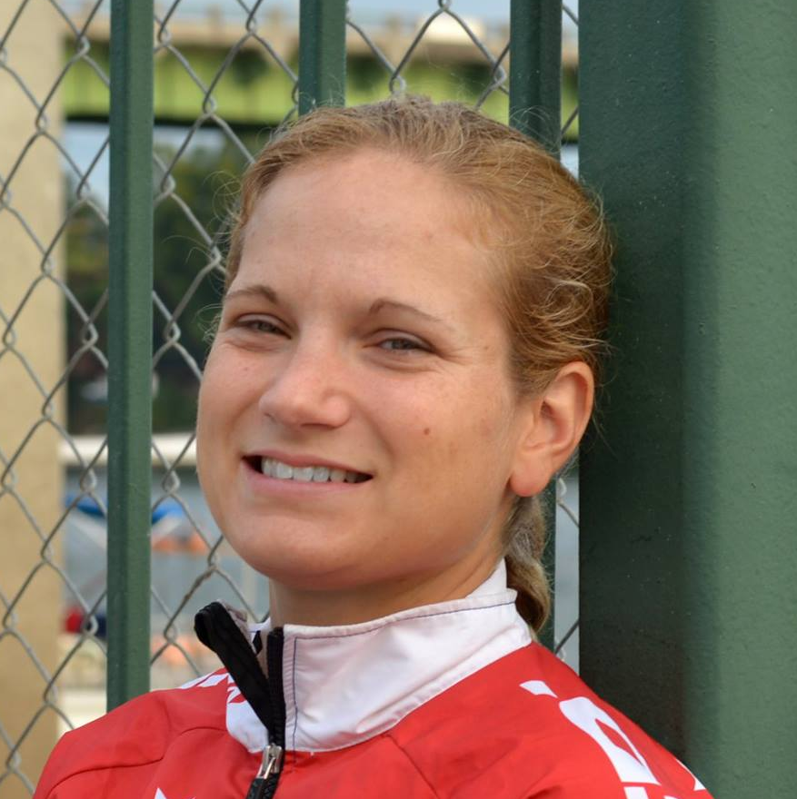
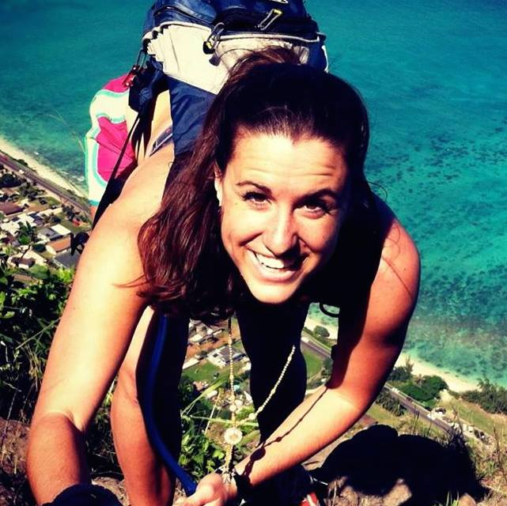
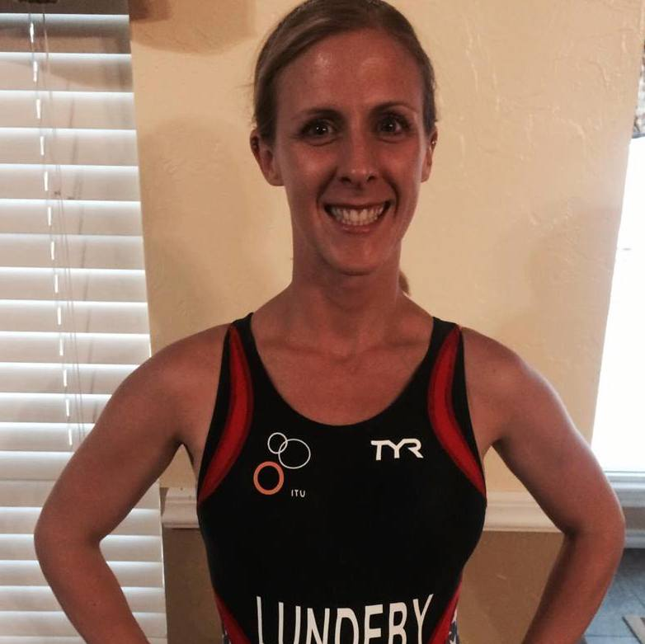
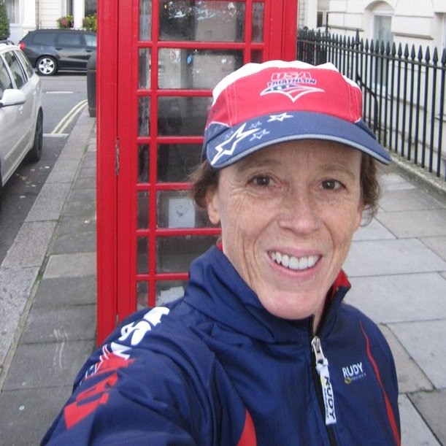
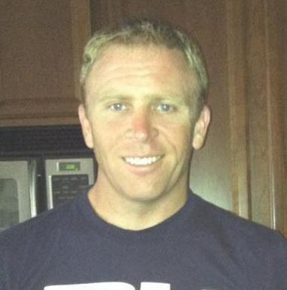
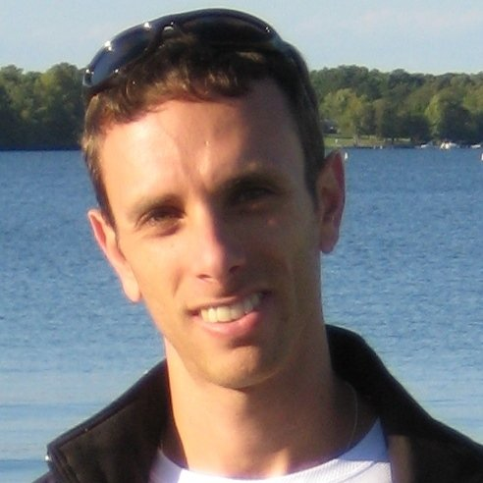
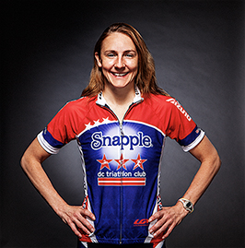
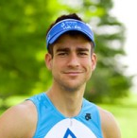
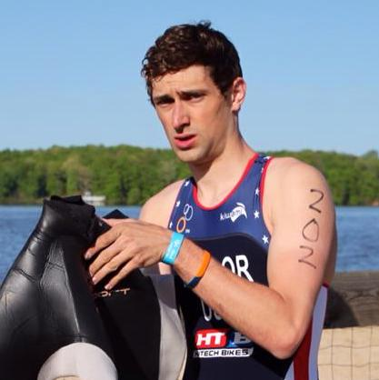
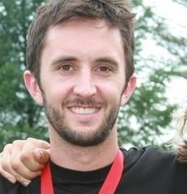
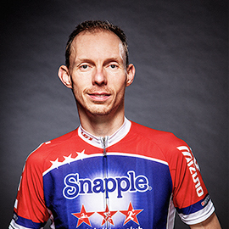
2015 DC Tri Club Snapple Team
In 2015 the team will continue to lead clinics, workouts, seminars and represent the club at races around the nation and around the world.
John Chambers
Stephanie Ewert
David Kraft
Mindy Ko
Emily Richard
Stephanie Brown
Bart Forsyth
Joe Munchak
Hilary Cairns
Holli Finneren
Camrynn Genda
Stephanie Lundeby
Cindy Hutchings
Reid Taylor
Mikal Davis
Lee Boyer
Adam Stolzberg
Bryan Frank

Slide 33
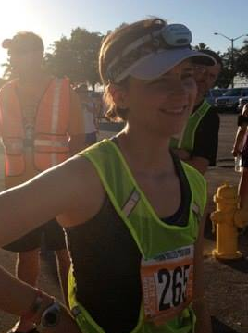
Club Awards
Presented by Rachel Dolan,
Director of Communications

Slide 34
Most Improved

Slide 35
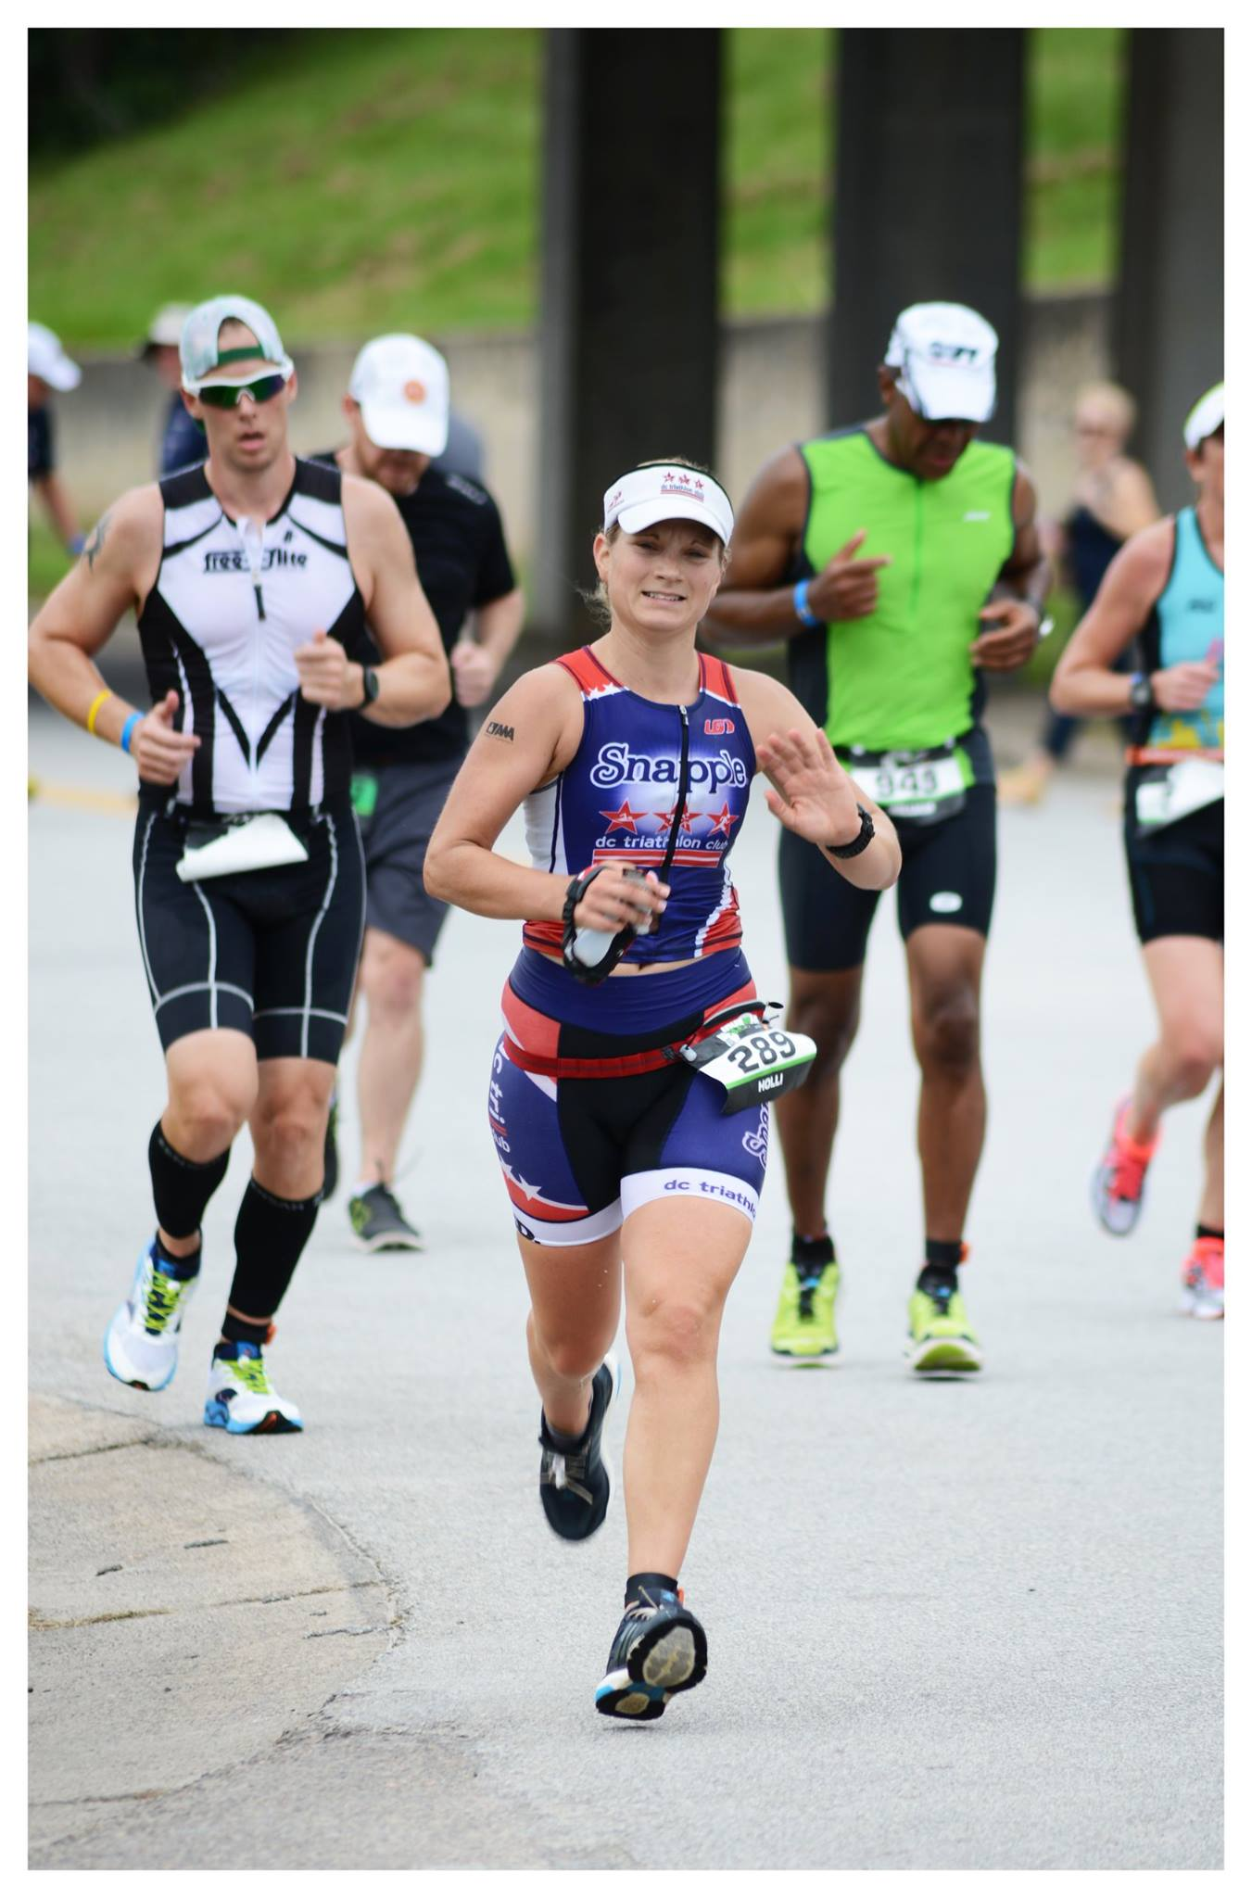

Holli Finneren & Pablo Torres

Slide 36
Rookie of the Year

Slide 37


Pinky Patel & Josh Ferguson

Slide 38
Veteran of the Year

Slide 39


Katie Tobin & Tuan Nguyen

Slide 40
Spirit of DC Tri

Slide 41

Cat Myung

Slide 42
Club Member of the Year

Slide 43


Adam Stolzberg

Slide 44
President’s Award

Slide 45

Adrienne Farfalla

Slide 46
Closing Remarks
Presented by Ryan Troll

