Slide 1
DC TRIATHLON CLUB
2015 Annual Meeting & Kona Viewing

Slide 2
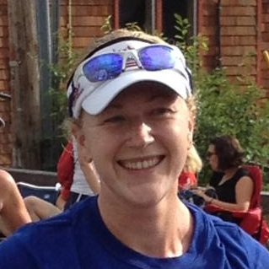
Welcome
Meaghan Jennison
President

Slide 3
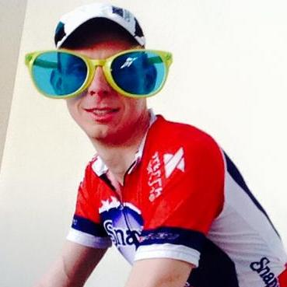
Financial Report
Bryan Frank
Treasurer

Slide 4
Financial Report - Growth
Notes:
4

Slide 5
Financial Report – Functional Areas
Notes:
5

Slide 6
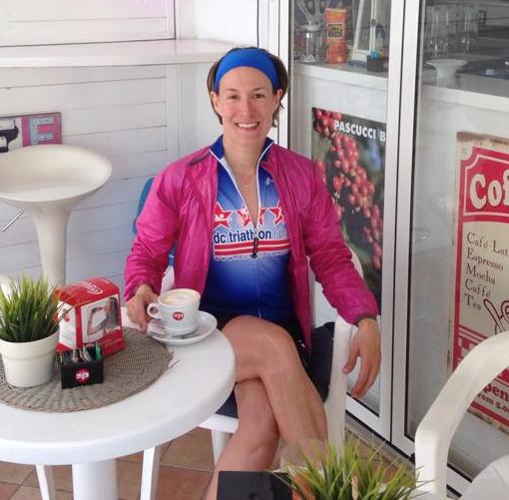
Membership Update
Becky Hirselj
Director of Membership Development

Slide 7
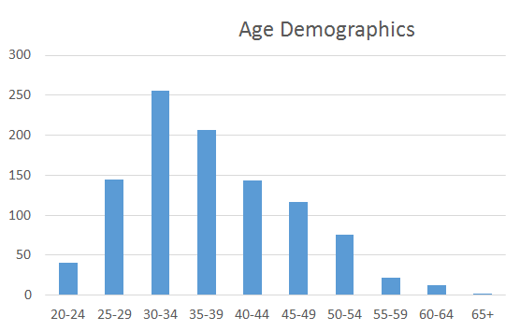


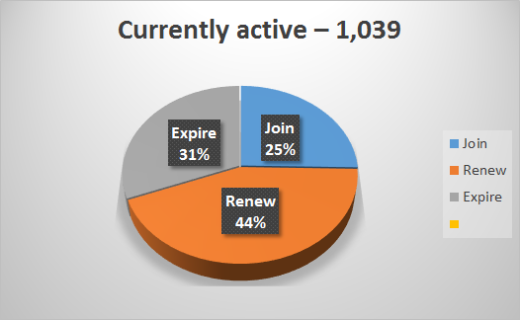
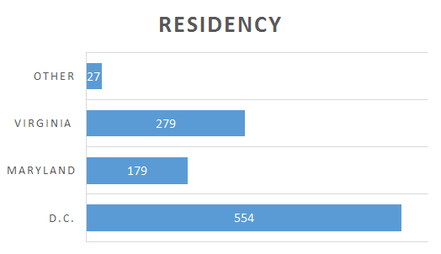
Membership Demographics
51%
49%
Notes:
7

Slide 8
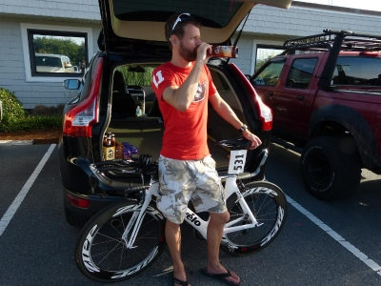
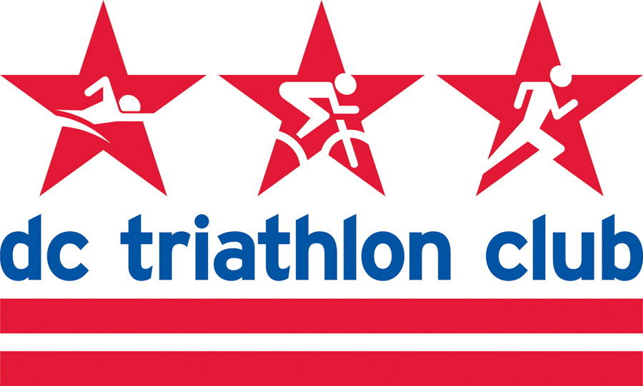
Program Highlights
Matt Ferguson
Director of Programs

Slide 9
Programs Overview
We are the only club in the nation to offer such a comprehensive suite of training programs! Regardless of where you are in your triathlon career, we have a training program designed to help you achieve your multisport goals!
New Triathlete Program (NTP) – designed for the newbie, guides athletes to the finish line of their first tri.
Olympic Distance Program (ODP) – two plans: the beginner/intermediate and intermediate/advanced.
Half IronMan Program (HIP) – takes athletes who have plenty of experience at shorter distances and builds the fitness and endurance necessary to tackle 70.3 miles of swimming, biking, and running.
IronMan Program (IMP) – designed for athletes who have raced at shorter distances and are looking to “go long” for the first time. Also designed for the veteran looking to train with a group, improve their PR, and looking for a cost-effective training plan.
Off-Season Spin Program (OSP) – a supplemental sport-specific training program to maintain and build cycling fitness during the offseason.
Masters Swim Program (MSP) – a supplemental sport-specific training program geared toward triathlon-specific swim training.
Elite Team Program (ETP) – representing the pinnacle of our club and our sport, the fastest among us train and race together as a team. Serving as role models and mentors, these elite athletes lead by example.
With 7 Programs, 30 volunteer staff members, and nearly 600 athletes,
our training programs are by far our largest membership touchpoint!

Slide 10
Program Personnel
None of this would be possible without the hard work and dedication of our program volunteers & coaches! As I call out the following names, please stand and be recognized.
New Triathlete Program (NTP) – Program Coach Will Grant, Program Lead Allison Nordberg, Co-Leads Jason Brezinski, Cat Myung, Mark Raugust, David Payne, Josh Ferguson, David Eng, Nia Dickett, Kyoko Kawai, Peter Roady, Alex Shiroma
Olympic Distance Program (ODP) – Program Coach Jule Miata, Program Lead Victoria Anderson
Half IronMan Program (HIP) – Program Coach AJ Morrison (Multisport In Motion), Program Lead Chris Jackson, Co-Leads Steve O’Donnell, Dena Richardson, Simon Hernaez, Cindy Hutchings
IronMan Program (IMP) – Program Coach AJ Morrison, Program Lead Chris Jackson, Co-Leads Patrick Pannett, Stephanie Brown, Lynn Follansbee, Karen Willard
Off-Season Spin Program (OSP) – Program Coach Ron Benedict
Masters Swim Program (MSP) – Program Lead Liana Rosen, Program Coaches Cat Myung, Katie Tobin, Jule Miata, David Payne, Thomas Colicchio, Will Schaefer, Kim Orsulak, Claudia Blackburn, Emerson Padiernos, Rachel Dolan, James Chu, Beth Plewa, Marisa Harrington, Daisy Letendre, Brenda Cordero

Slide 11
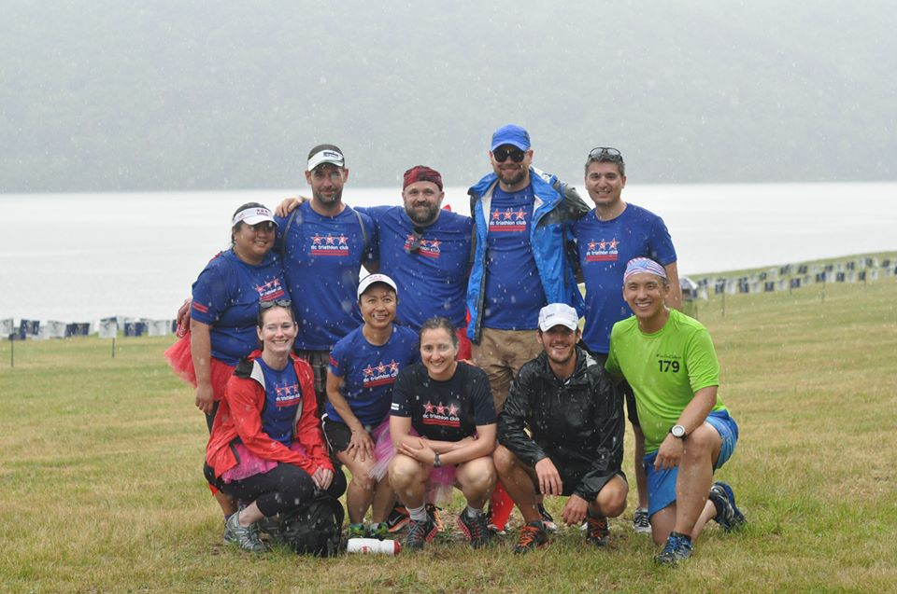
For all that you do to make our programs a success, THANK YOU!!!

Slide 12
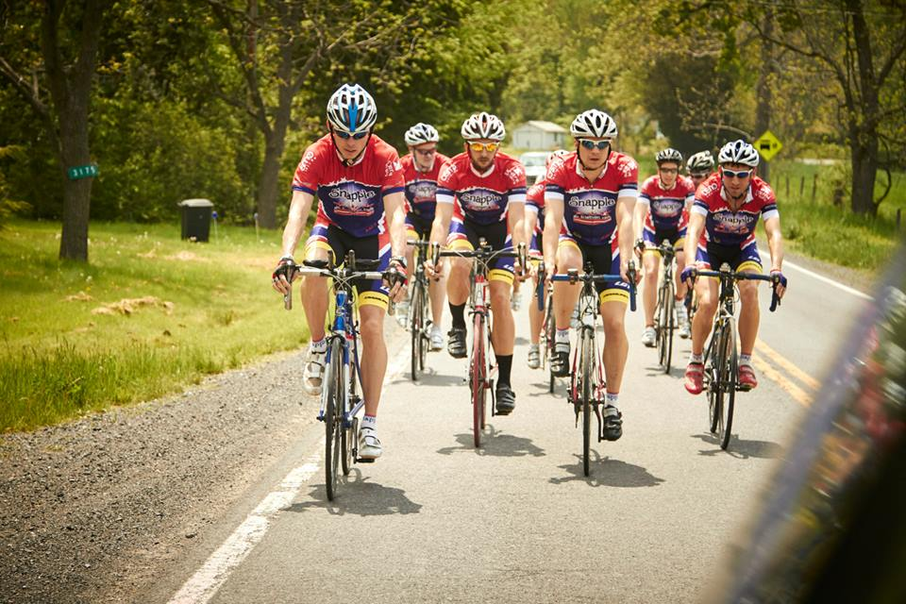
DC Tri Club / Snapple Elite Team

Slide 13
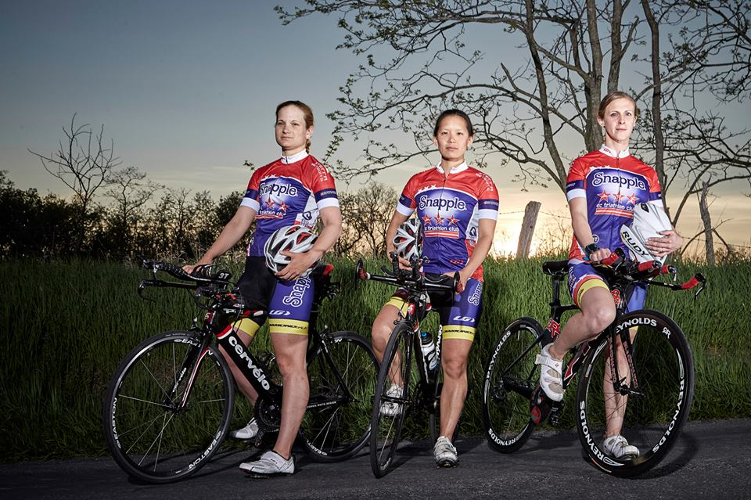
First…the women

Slide 14
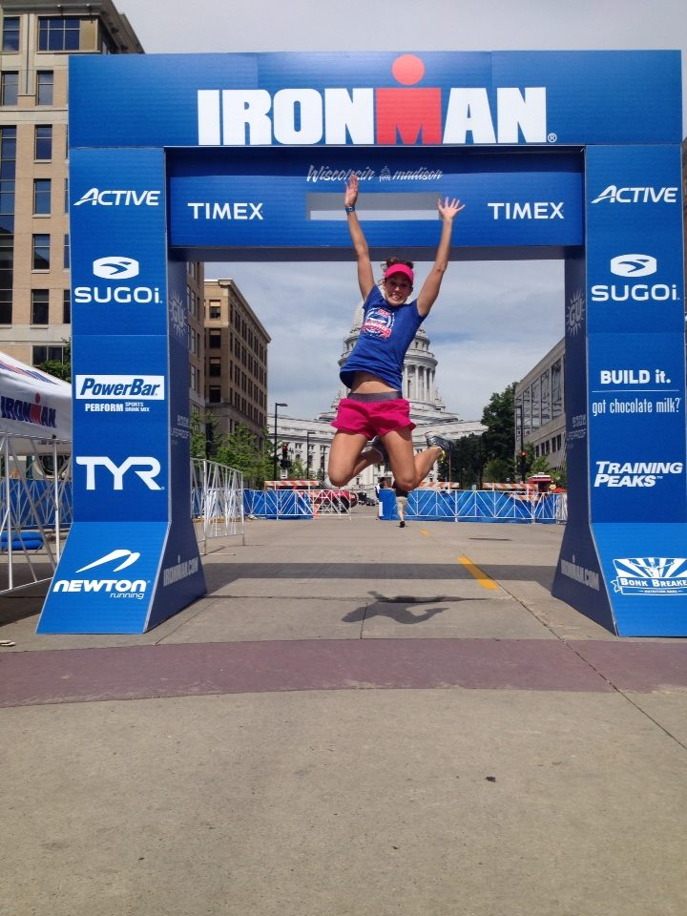
Heather Prochnow

Slide 15
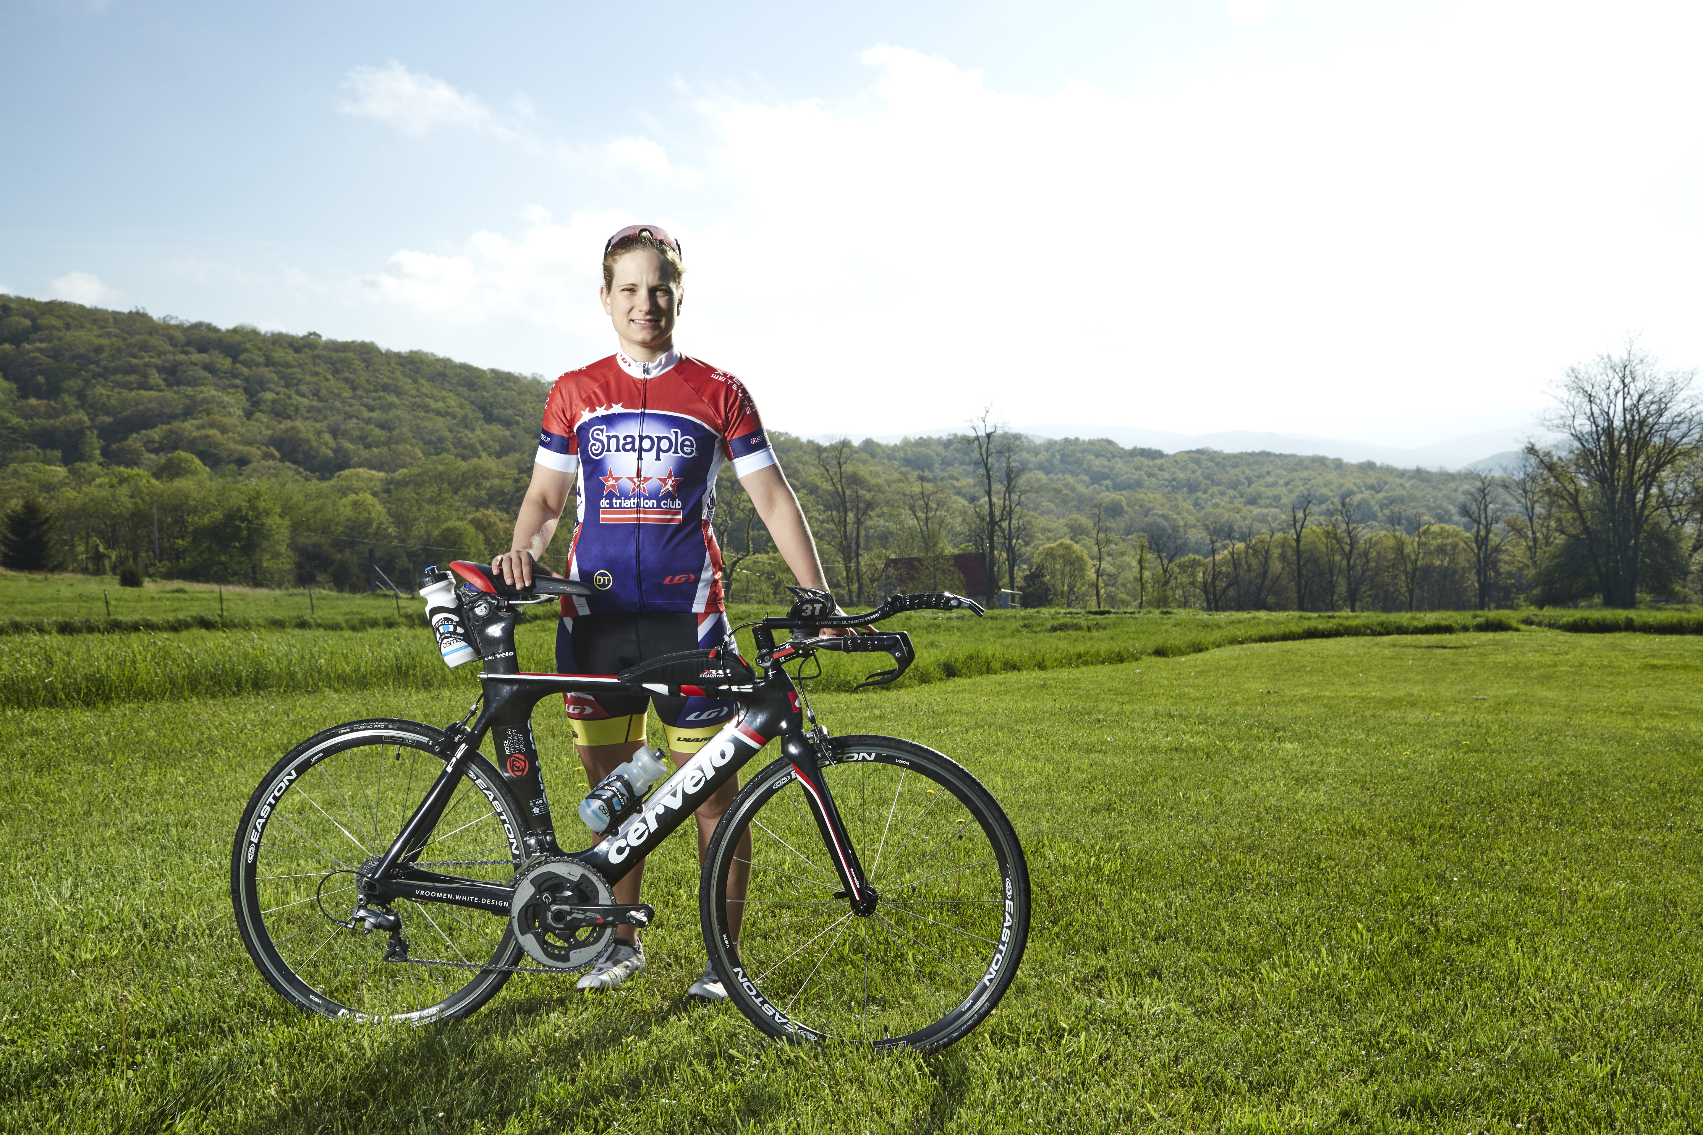
Holli Finneren

Slide 16
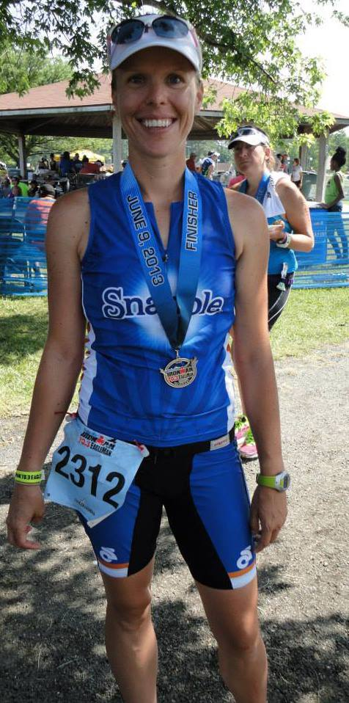
Leslie Puzio

Slide 17
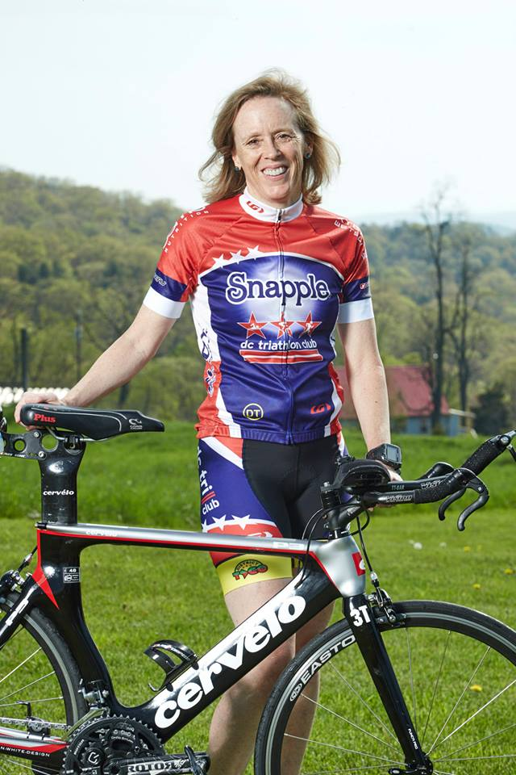
Cindy Hutchings

Slide 18
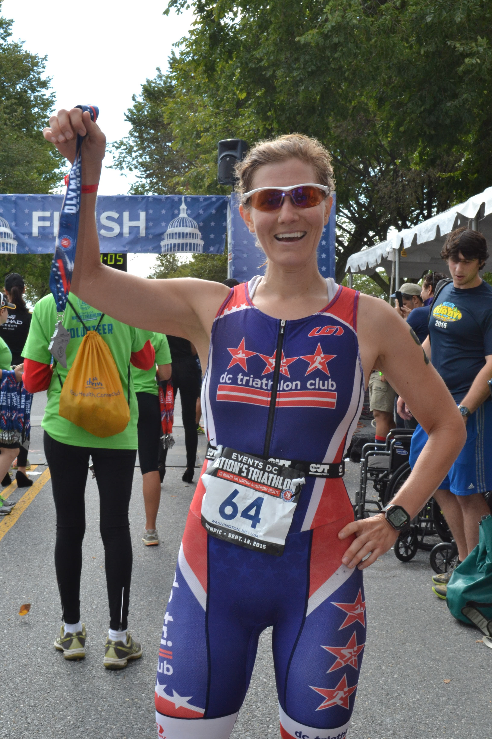
Paige Wooden

Slide 19
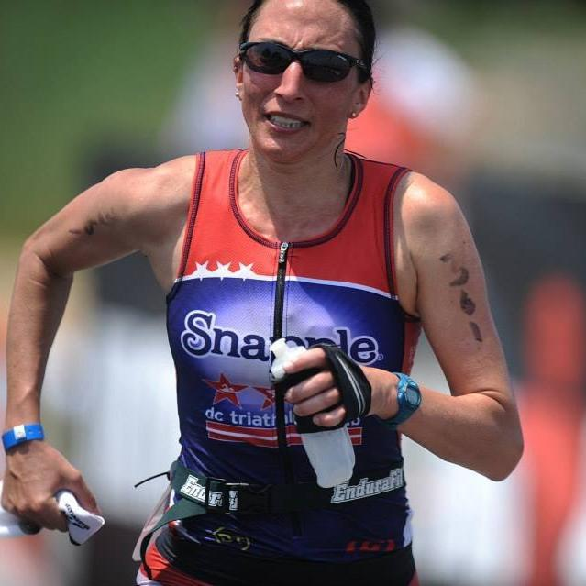
Emily Richard

Slide 20
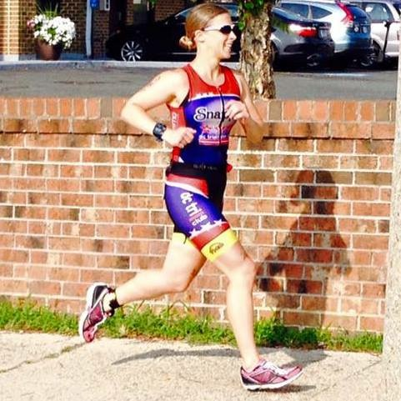
Stephanie Lundeby

Slide 21
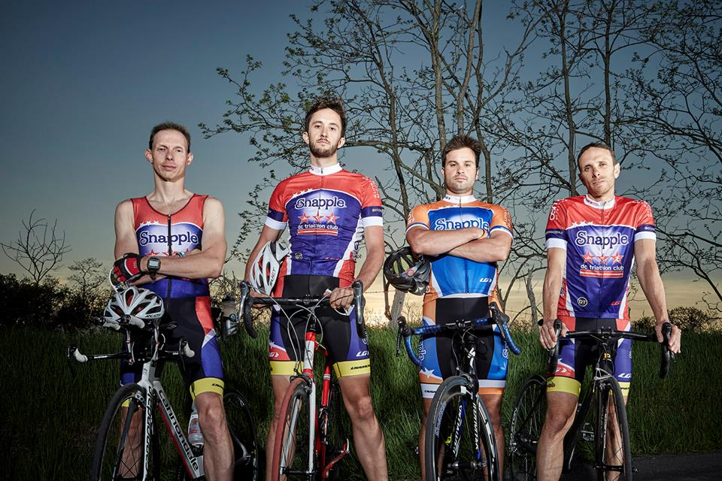
Now…the men

Slide 22
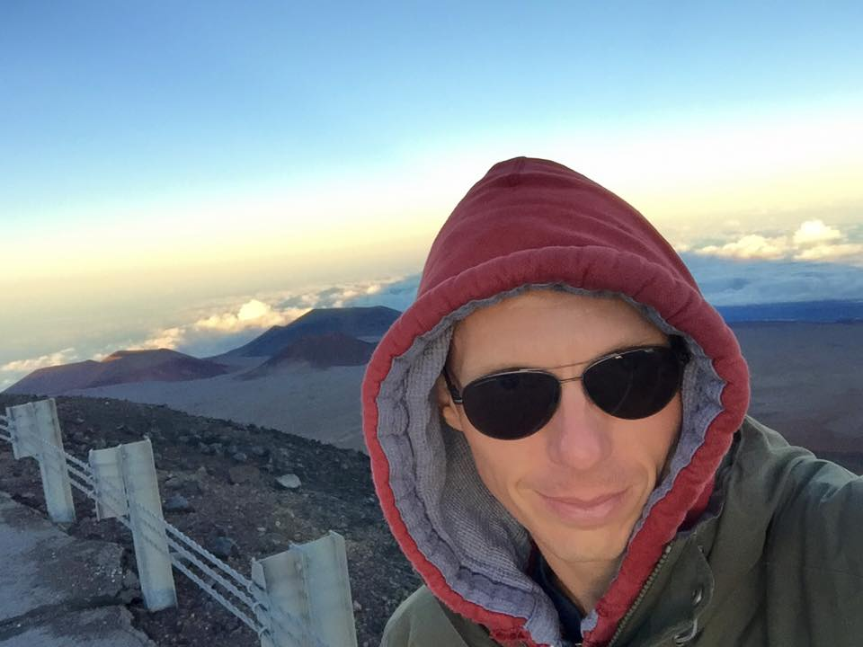
Bryan Frank

Slide 23
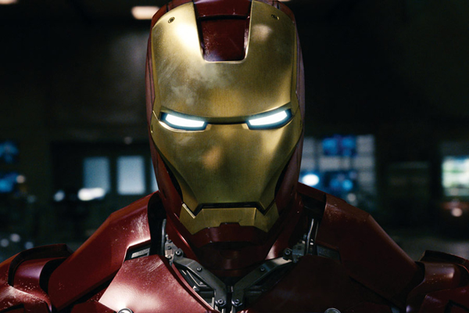
or… Bryan Frank

Slide 24
you decide!

Slide 25
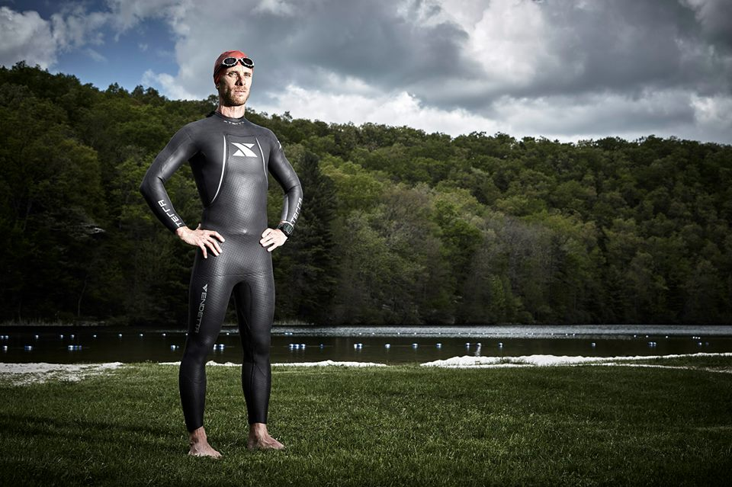
Adam Stolzberg

Slide 26
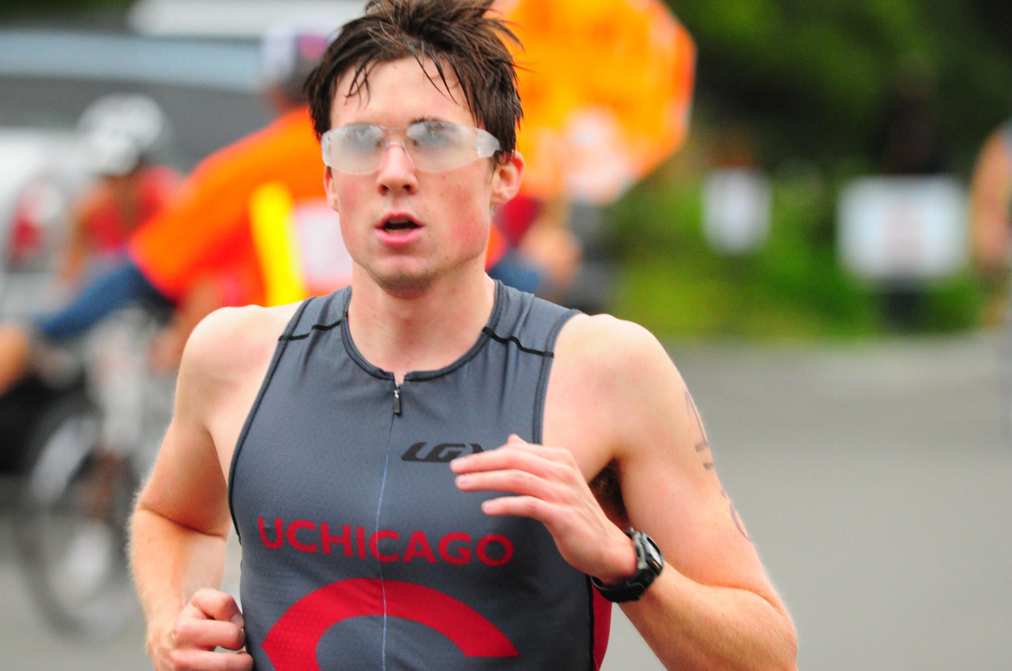
Alex Murray

Slide 27
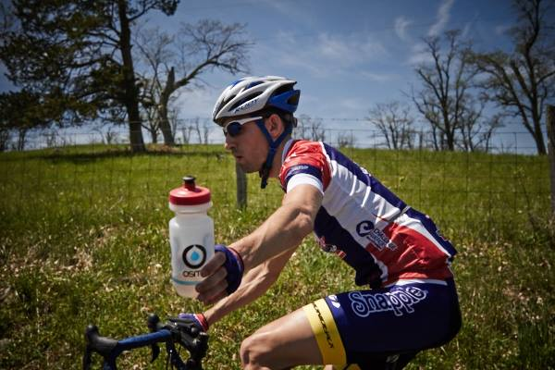
Joe Munchak

Slide 28
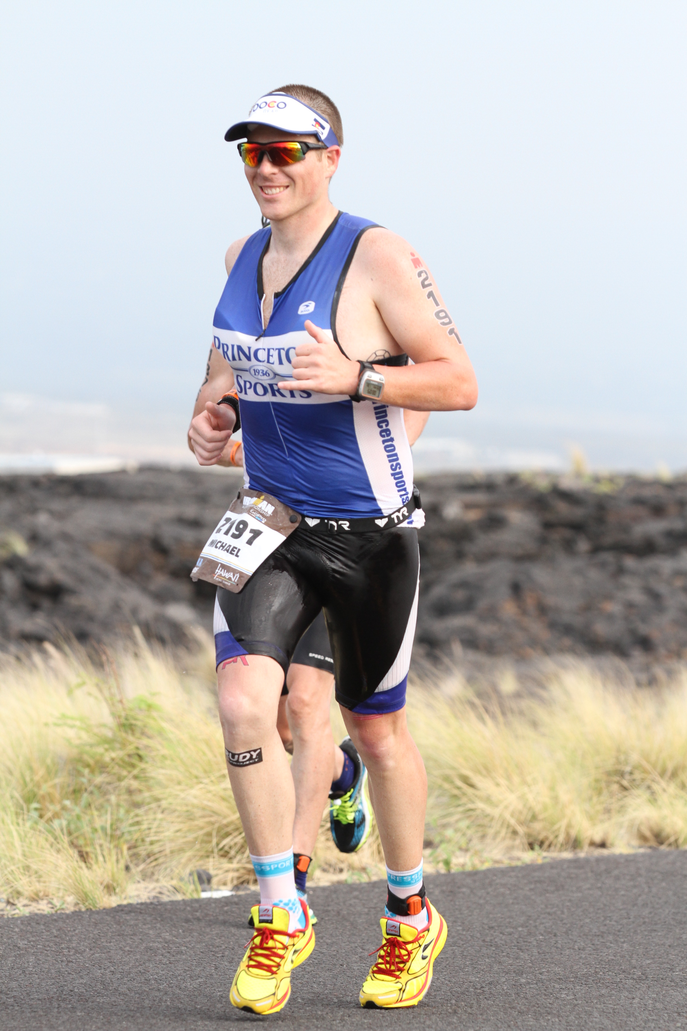
Michael Hepp

Slide 29
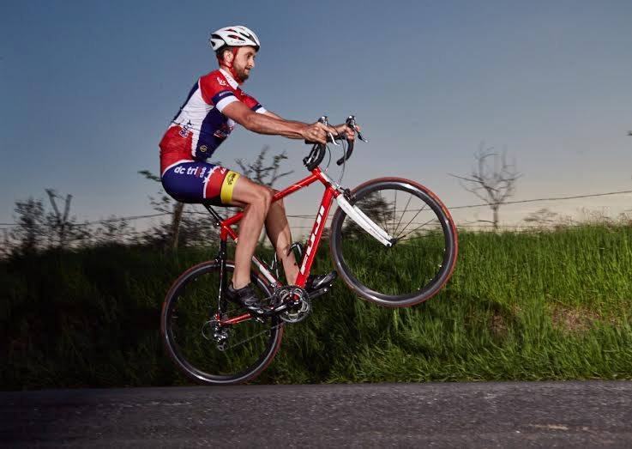
Mikal Davis

Slide 30
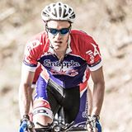
John Chambers

Slide 31
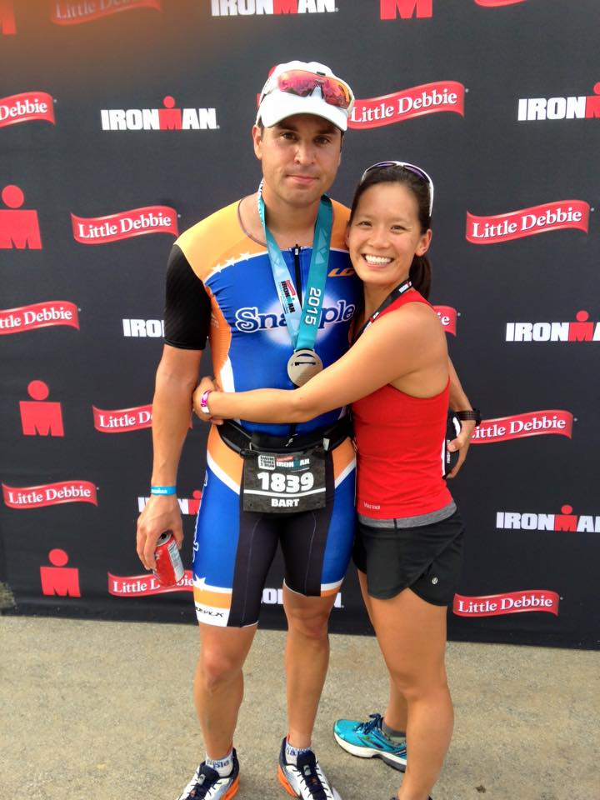
Bart Forsyth & Mindy Ko

Slide 32
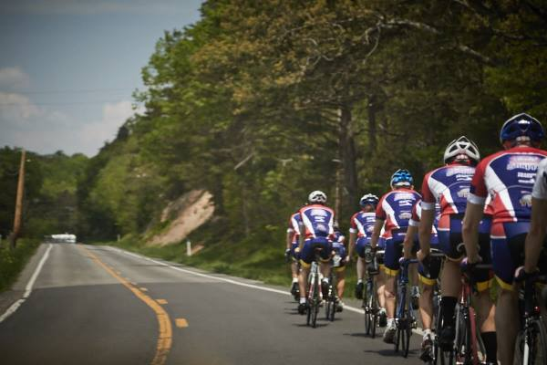
Congratulations Elite Team Athletes!

Slide 33
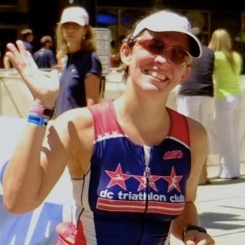
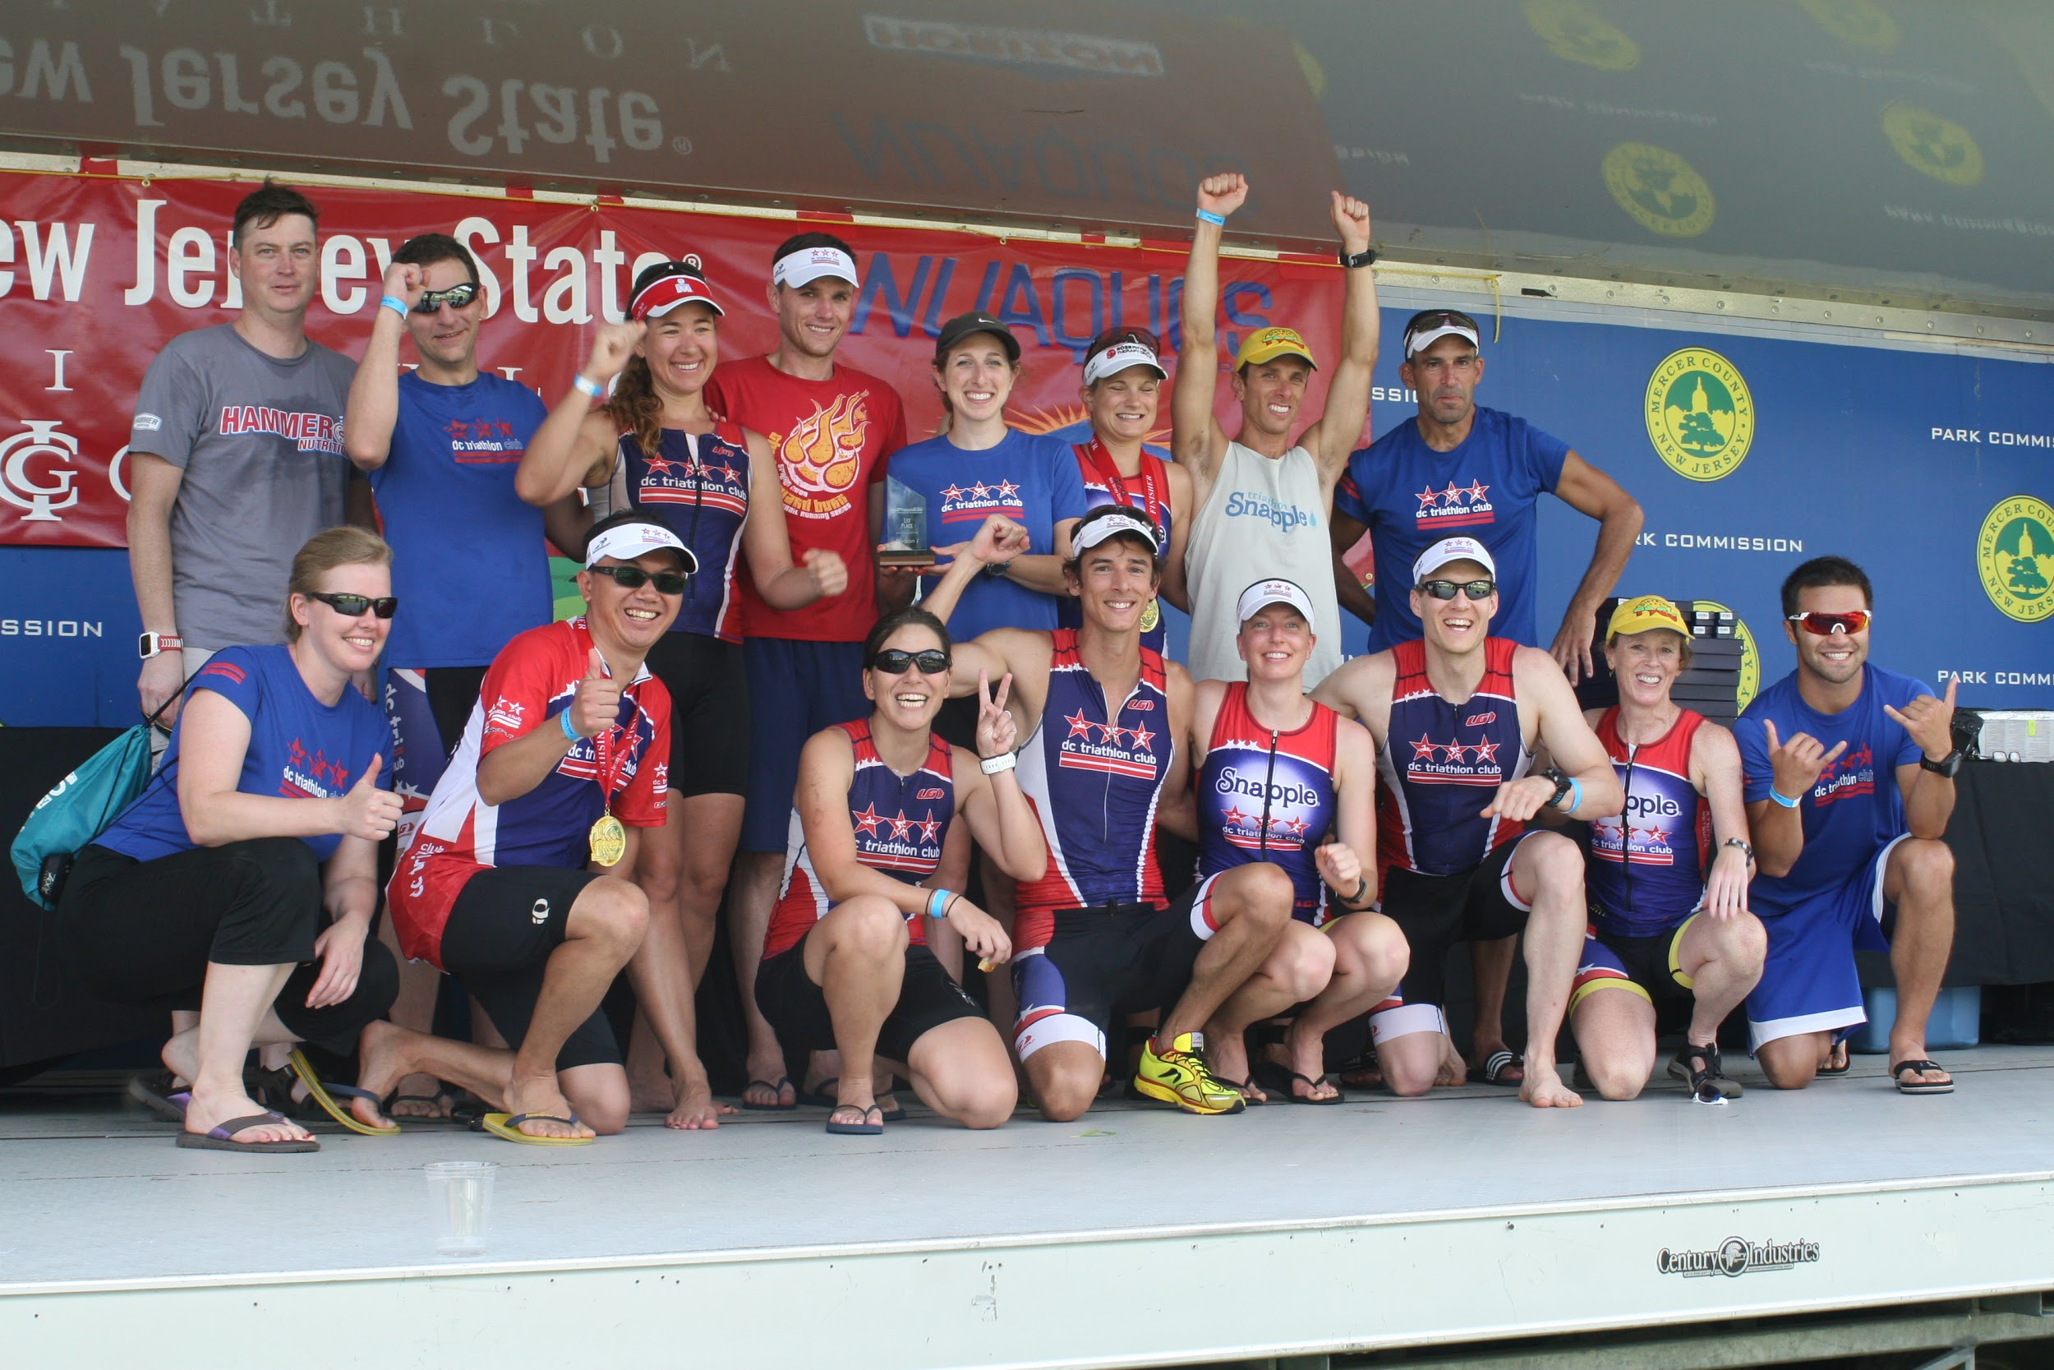
Club Training & Racing
2015 Training Events:
Columbia BrickNic
Nation’s BrickNic
French Creek Training Weekend
Deep Creek Training Weekend
Gabi Torres
2015 Club Races & Competitions:
National Club Challenge
Trimania Team Challenge
Rock Creek Park Spooky Sprint 5k
10x Mid-Atlantic Regional Club Champions
Thanks to our Training and Racing Leads:
Pro-Triathlete John Kenny
Amanda Melillo
Sarah Lifsey
Kathleen McDonnell
Hillary Peabody & Team
Hilary Cairns
Mark Raugust
Meghann Jones
Daniel Riegel
Amanda Chadwick
Tuan Nguyen

Slide 34
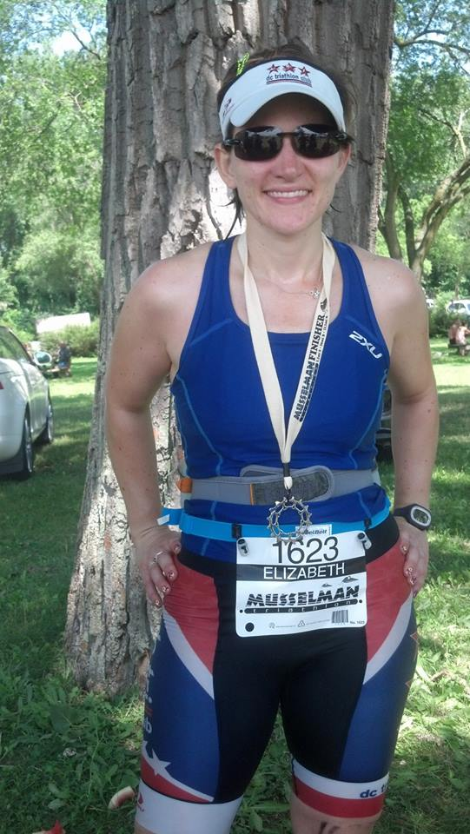
Community Groups
Elizabeth Corona
Director of Community Groups

Slide 35
Community Groups
TriOut – A community group of gay, lesbian, bixsexual, and transgender (LGBT) Club members and friends looking to train, socialize, and interact. All levels are welcome.
Montgomery County (“Mafia”) – A community group of Club members who live, work, and/or train in Montgomery County, MD. All levels are welcome.
Capitol Hill – A community group of Club members who live, work, and/or train on Capitol Hill. All levels are welcome.
Slow to Moderate Pace Group – A community group of the club's members who multi-sport athletes who swim, bike, or run at a moderate to slower pace.
Fairfax Alexandria Arlington Springfield Training Group (FAAST) – Geographic based community group of Club members who live, work, and/or train in the Alexandria area. All levels are welcome.
If you are interested in forming and leading/co-leading a community group contact Elizabeth Corona at community@dctriclub.org

Slide 36
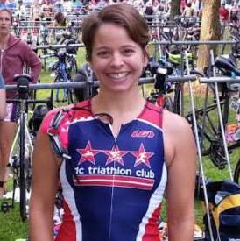
Gear & Merchandise
Shop - Full functionality will return by January 1, 2016
API
  API is a full service branded merchandise agency and ecommerce fulfillment company located in Lanham, MD
  They will be handling all our gear purchasing, procurement, shipping and customer service needs
Under Armour Running Gear
  Running singlets and other UA gear will be debuted in early Spring 2016
Louis Garneau Fit Kit – We will have the LG Fit Kit at various TBD events and locations through-out the area mid-Feb to mid-March 2016. Keep an eye out for those announcements.
If you have ideas or suggestions or want to help with our LG fit kit and gear purchasing events, please e-mail gear@dctriclub.org
Jen Hartz

Slide 37
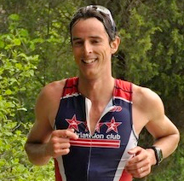
Partnerships
Pablo Torres
Director of Partnerships
Notes:
37

Slide 38








Local Partners

Slide 39





Online/National Partners

Slide 40

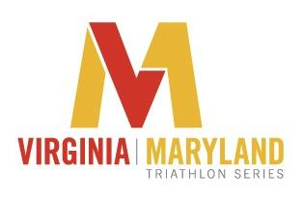


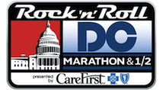





Racing Partners

Slide 41

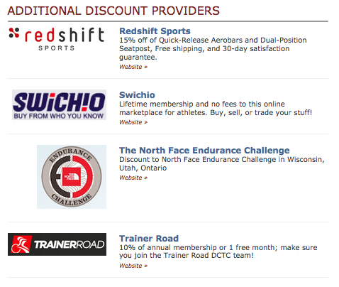

Contributors, Affiliates, and
Additional Discount Providers
Notes:
41

Slide 42

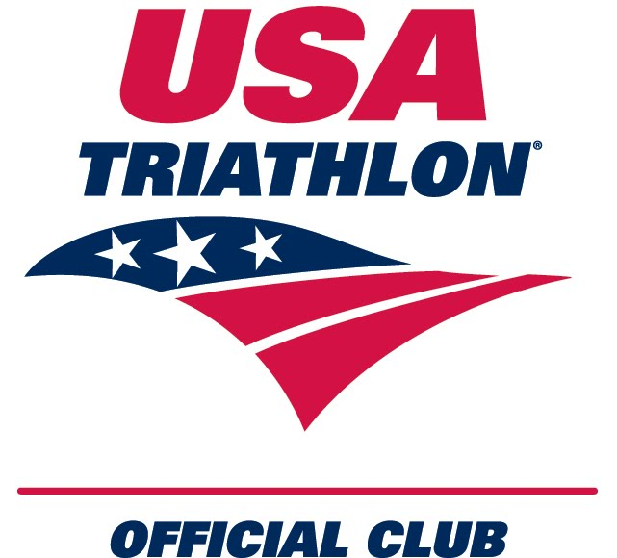
USA Triathlon
Cory Churches
Chair
USA Triathlon
Mid-Atlantic Region
2016 News
Notes:
42

Slide 43
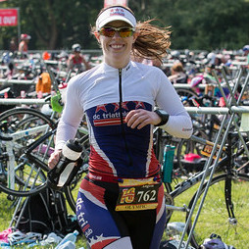
Volunteer Recognition
Angela Norcross
Director of Club Events

Slide 44
Volunteer Recognition
Volunteers are key to our success!
In 2015, club members donated more than 5,000 hours of their collective time
Hundreds of members volunteered their time in 2015 to support the club and our partners
The following members were recognized by their peers as going above and beyond…
Amanda Chadwick
Pam Simmonds
Will Grant
Cat Myung
Allison Nordberg
Amanda Melillo
Ed Moser
Kathleen McDonnell
Sarah Lifsey
Rob Read
Tuan Nguyen
Jason Brez
Mark Raugust
David Eng
Jason Crawford
Dominique Mack
Mark Myley
Paige Wooden
Ali Davis
Patrick Morand
Cindy Hutchings
Kyle Simpson
Joyce Jones
Hernando Herrera
Jen Carroll
Magnus Solheim
Nicole Armbruster
Heather Barbier
Axel Kirstetter

Slide 45
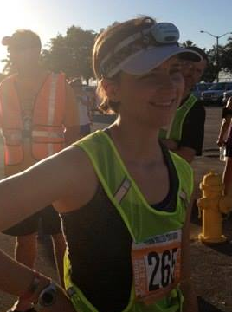
2016 Board of Directors
& Staff
Rachel Dolan
Secretary

Slide 46
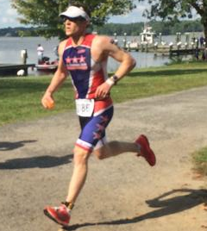
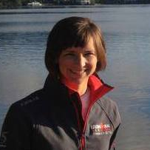
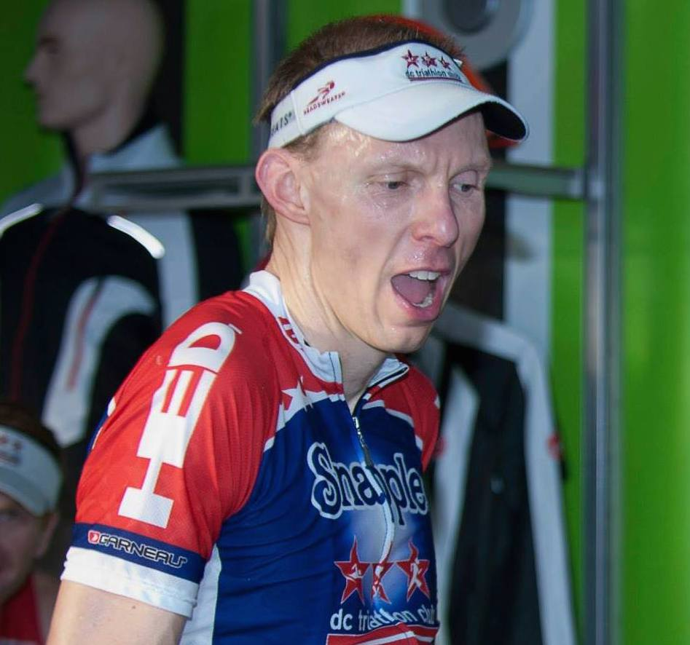
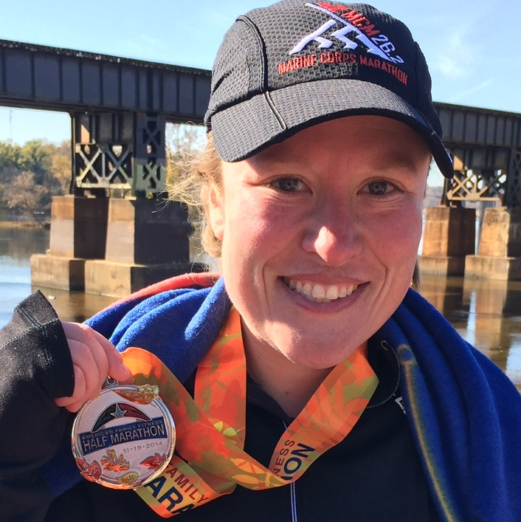
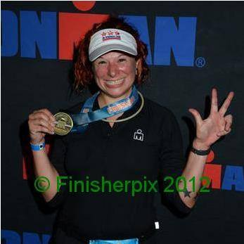
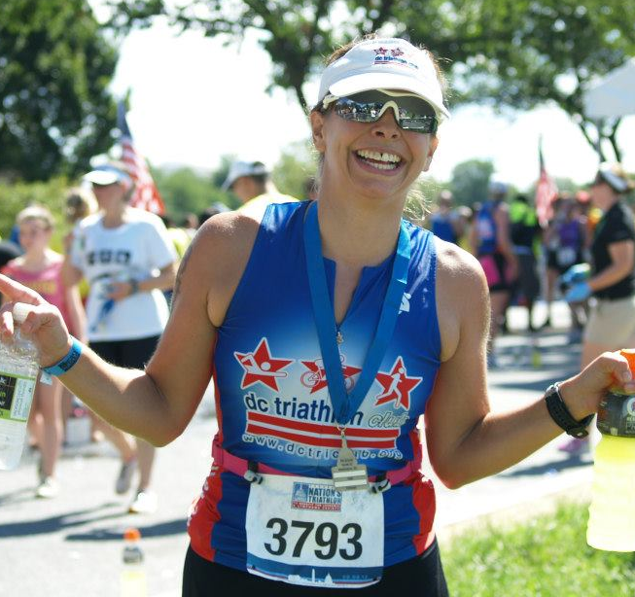
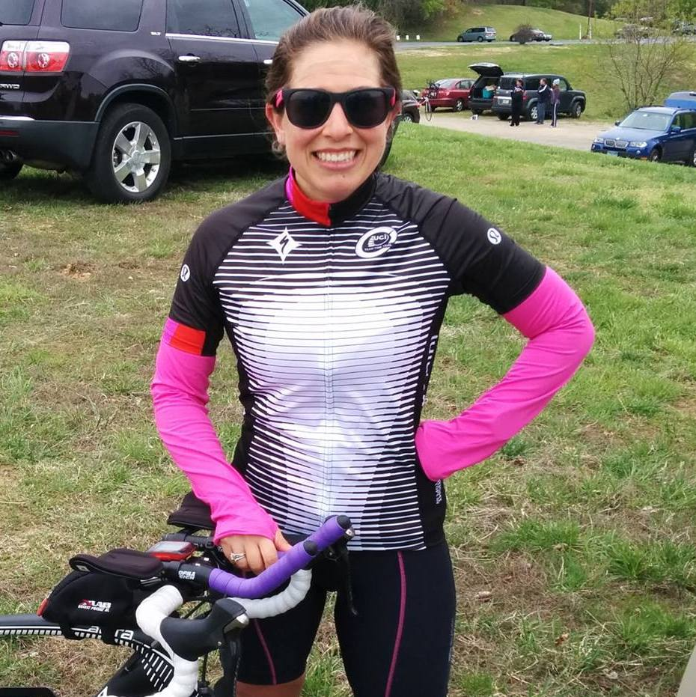
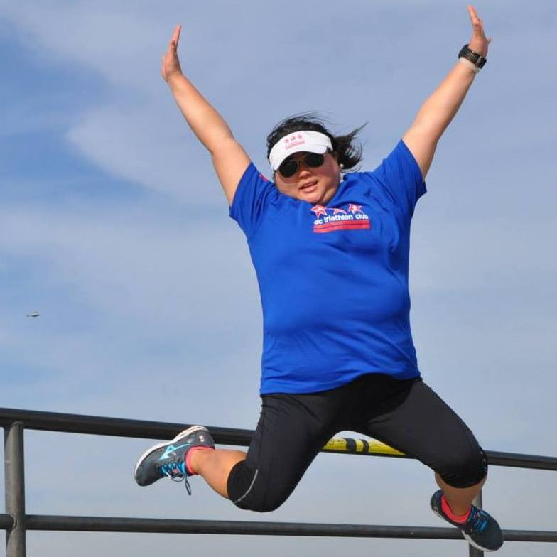
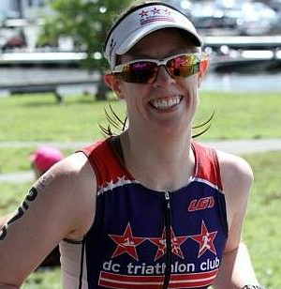
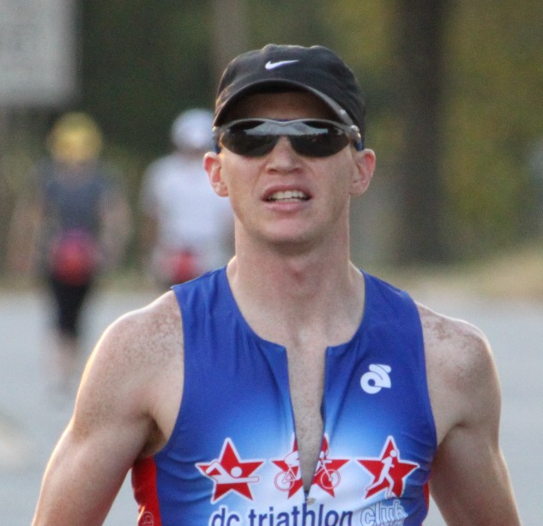

2016 Board of Directors
Justin Bauer
Elizabeth Corona
Rachel Dolan
Matt Ferguson
Bryan Frank
Liz Glomb
Tania Grollman
Jennifer Hartz
Becky Hirselj
Amanda Melillo
Cat Myung
Angela Norcross
Nik Pleisch
Gabi Torres
Pablo Torres

Slide 47


2016 Board Advisors & Staff
Rob Falk
Legal Advisor
Adrienne Farfalla
Staff

Slide 48

Club Awards
Nik Pleish
Vice President

Slide 49
Most Improved

Slide 50


Christina Lauer & Mark Raugust

Slide 51
Rookies of the Year

Slide 52


Luciana Juvenal & Eran Gourdes

Slide 53
Veterans of the Year

Slide 54


Holli Finneren & Bryan Frank

Slide 55
Spirit of DC Tri

Slide 56

Gabi Torres

Slide 57
Club Member of the Year

Slide 58

Tuan Nguyen

Slide 59
President’s Award

Slide 60

Jen Hartz

Slide 61
Closing Remarks

